Slide 1
An Empirical Study of the Usage of the Swarm App’s Cross-Site Sharing Feature
Shihan Lin¹, Rong Xie¹, Yang Chen¹, Yu Xiao², Pan Hui³
¹Fudan University, China
²Aalto University, Finland
³University of Helsinki, Finland
Notes:
Hello everyone,
transition: Let’s first talk about Swarm.

Slide 2

Swarm
Swarm, a representative Online Social Network (OSN)
Make friends & check-ins
Time
Location
Notes:
transition: Since there are so many online social networks now, the OSNs often provide the service of cross-site linking.

Slide 3
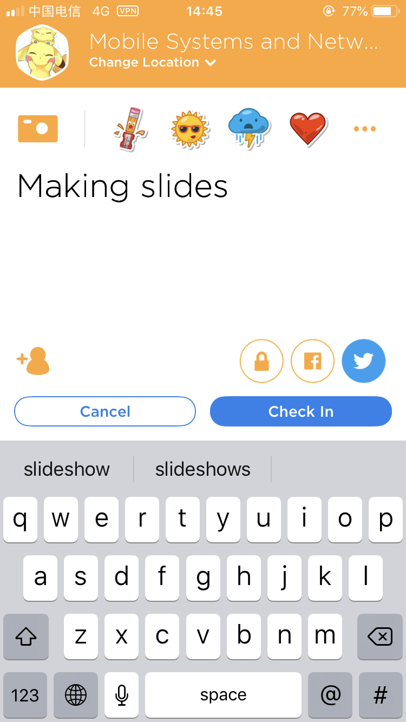

Cross-Site Linking
Sign-in Swarm with the Facebook account Share the check-in to Twitter
shared-to-Twitter check-in
Notes:
For example, you can
As the picture shows, if
We call this type of check-in as shared-to-Twitter check-in
transition: So here comes our motivation.

Slide 4
Motivation
Check-ins are only visible to friends on Swarm
A common solution: collect check-ins from Twitter If a check-in is shared to Twitter, it is public
Reference: [Cheng et. al. ICWSM’11], [Cranshaw et. al. ICWSM’12], [Preotiuc-Pietro, WebSci’13 ], [Hecht et. al. ICWSM’14]
Representativeness Problem:
Can those shared-to-Twitter check-ins represent the check-ins directly collected from Swarm ?
Whether the researchers can draw the the same conclusions from these two datasets ?
Notes:
Since check-ins are only visible …
It prevent researchers from collecting check-in data (click)
But there is a common solution ...
(click) But here comes the representativeness problem
transition: So here comes our work.

Slide 5
Our work
The factors that can affect users’ cross-site sharing behavior
Investigate the representativeness problem e. g. Suppose users prefer sharing check-ins at restaurants
Users prefer check-in at other places
Users prefer check-in at restaurants
Notes:
We investigate... It is important because
Let me give you an example. Let’s suppose that ...
so the restaurant is a factor that can affect users sharing behavior
If a researcher
(click)He will find so many check-ins are created at restaurant
Then he may conclude
But if he
(click)He would not draw the same conclusion
This difference is caused by the assumption that
Even though they don’t check-in frequently at restaurants
but they share many check-ins at restaurants, and seldom share check-ins at other places
So we investigate the representative problem through the influential factors.

Slide 6
Our work
The factors that can affect users’ cross-site sharing behavior
Investigate the representativeness problem e. g. Suppose users prefer sharing check-ins at restaurants
Help OSNs know better about their sharing features (improve users’ experience)
Notes:
(click) And this work can also help OSNs
transition: In this work, we collect check-ins directly from Swarm

Slide 7
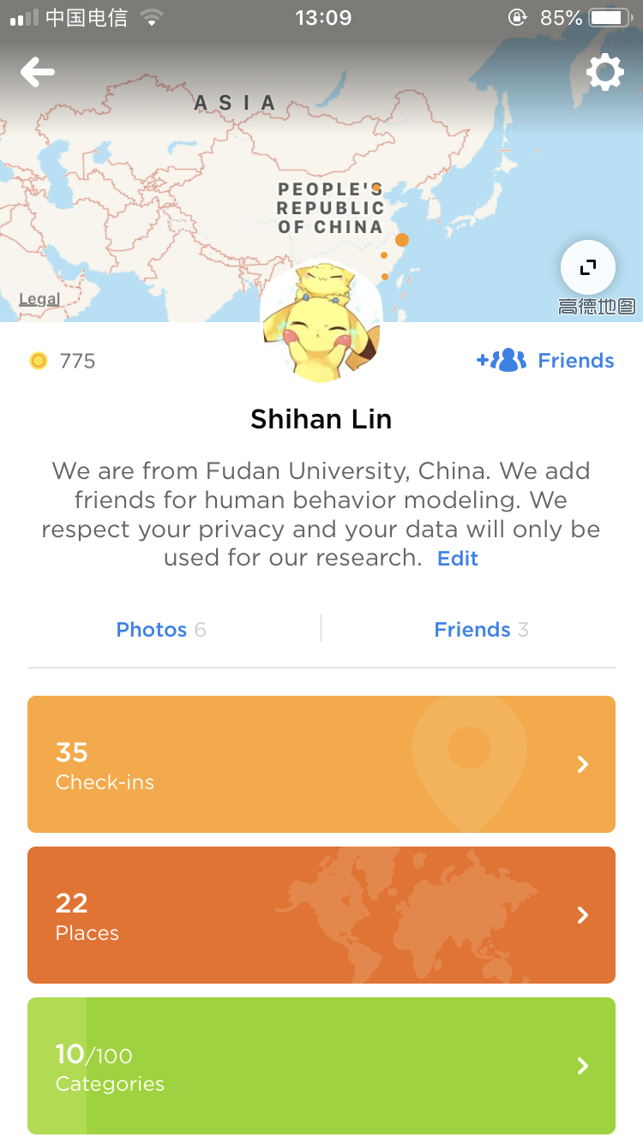
Dataset
Collect check-ins directly from Swarm
Randomly select Swarm users who have linked accounts to Twitter
Send friend requests
Privacy descriptions on accounts’ profiles
Collect friends’ check-ins
Notes:
We randomly
(click) and send friend requests to them
To respect users' privacy, we have ...
If a user accept

Slide 8
Dataset
10 million check-ins from 6050 users
“Whole group”
1 million of them are shared to Twitter
“Shared subgroup”
Notes:
transition: Now we have the dataset, we can start our analysis on influential factors

Slide 9
Factors
Individual factors
Check-in-related factors
Time, venue category, text length, the previous check-in’s status
Profile-related factors
Gender, the number of Swarm friends, the number of Twitter followers
Statistical analysis
Combinations of factors
Predict users’ sharing decisions with machine learning
Notes:
We classify factors into 2 categories,
For individual factors, we consider 2 kinds of factors

Slide 10
Factors
Individual factors
Check-in-related factors
Time, venue category, text length, the previous check-in’s status
Profile-related factors
Gender, the number of Swarm friends, the number of Twitter followers
Statistical analysis
Combinations of factors
Predict users’ sharing decisions with machine learning
Notes:
Transition: Now let’s start by check-in-related factors

Slide 11
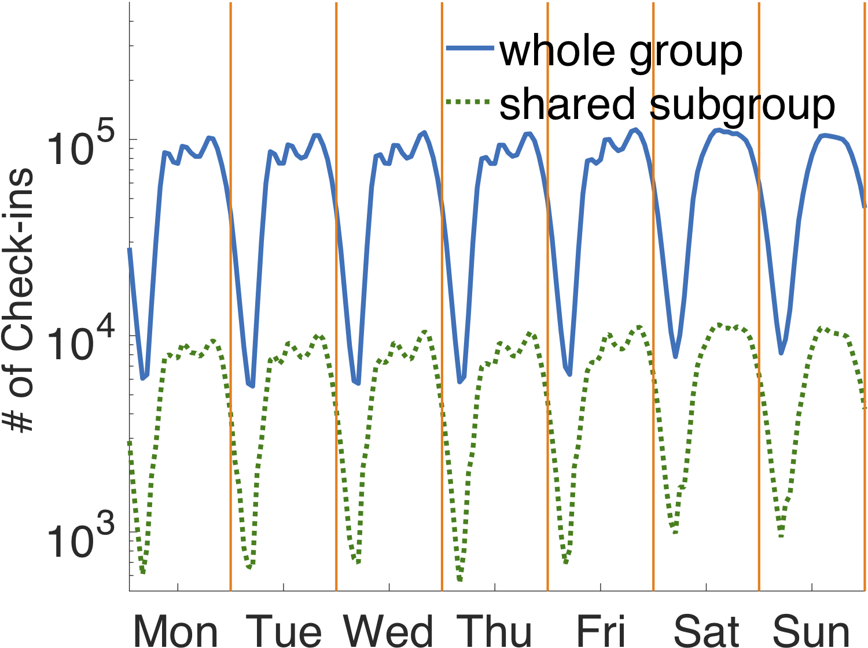
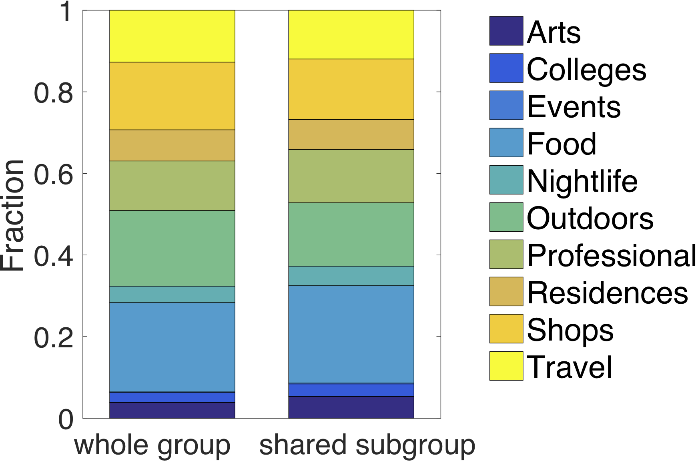
Individual Factors (Check-in-related)
Creation time and venue category do not affect users’ sharing behavior
Notes:
Here are two pictures.
The left one shows the number of check-ins in the whole group and shared subgroup per hour during a week
The right one
It can be found that there is no
So we conclude that
transition: We know that users can attach text with their check-ins, and so we’d like to know how text length will affect users.

Slide 12
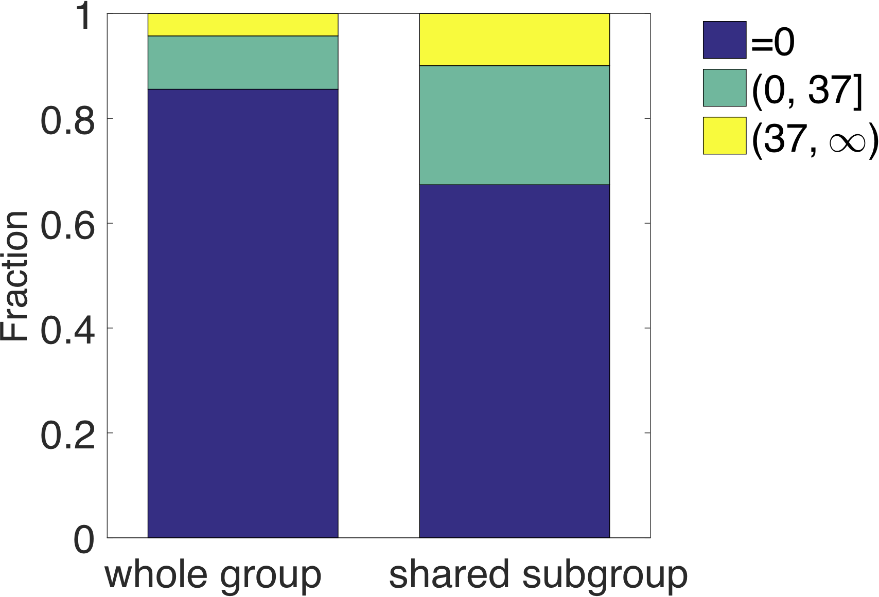
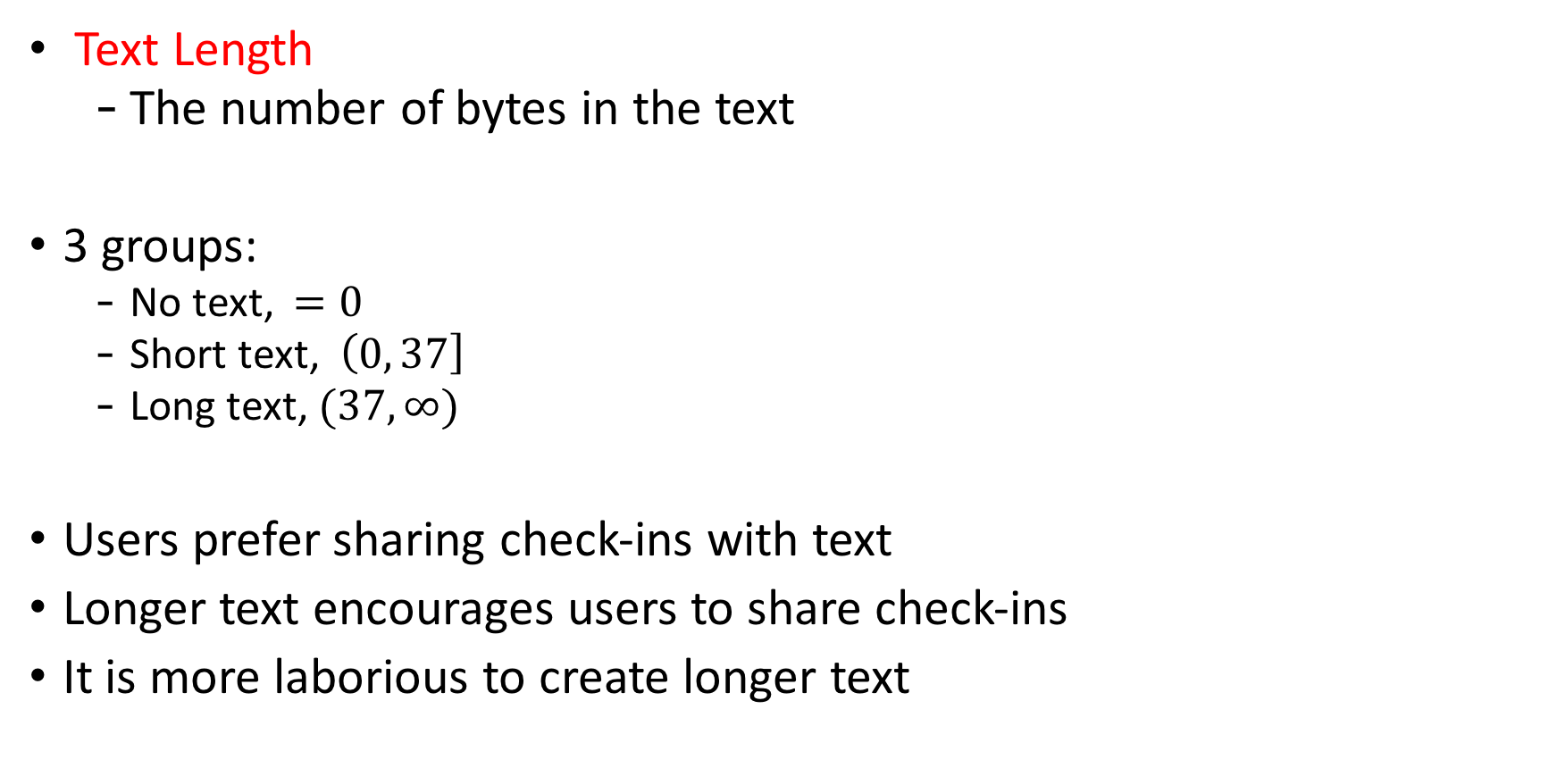
Individual Factors (Check-in-related)
Text Length
The number of bytes in the text
3 groups:
No text, $=0$
Short text, $\left(0, 37\right]$
Long text, $(37, ∞)$
Users prefer sharing check-ins with text
Longer text encourages users to share check-ins
It is more laborious to create longer text
Notes:
We define
We divide check-ins into
We can see a slight difference
And we conclude that, firstly, (click)
and secondly (click)
It really makes sense …., so the user would like the check-in to be seen by more people.
transition: Now, I would like to present an interesting result for you.

Slide 13
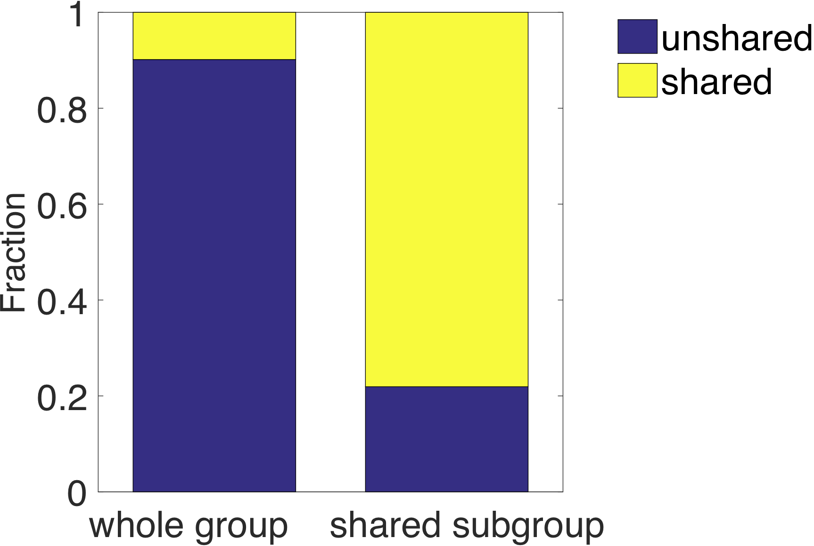
Individual Factors (Check-in-related)
History factor
Whether the previous check-in is shared
Totally different
Two possible reasons:
The default setting of Swarm encourages users to share check-ins
The nature of time locality in users’ sharing behavior
Notes:
We define a history factor
We can find that the fractions in two groups
which means that this history factor can affect users sharing decision a lot
We think there may be two possible reasons
Firstly, on Swarm, if you shared a check-in before, then the Twitter button
We think this default setting has encouraged users to experience the sharing feature.
Secondly, there may be a nature
It means that during a period of time, users enjoy
transition: We have finished the check-in-related factors, then I will present the profile-related factors.

Slide 14
Factors
Individual factors
Check-in-related factors
Time, venue category, text length, the previous check-in’s status
Profile-related factors
Gender, the number of Swarm friends, the number of Twitter followers
Statistical analysis
Combinations of factors
Predict users’ sharing decisions with machine learning
Notes:
We have finished the check-in-related factors, then I will present the profile-related factors.

Slide 15
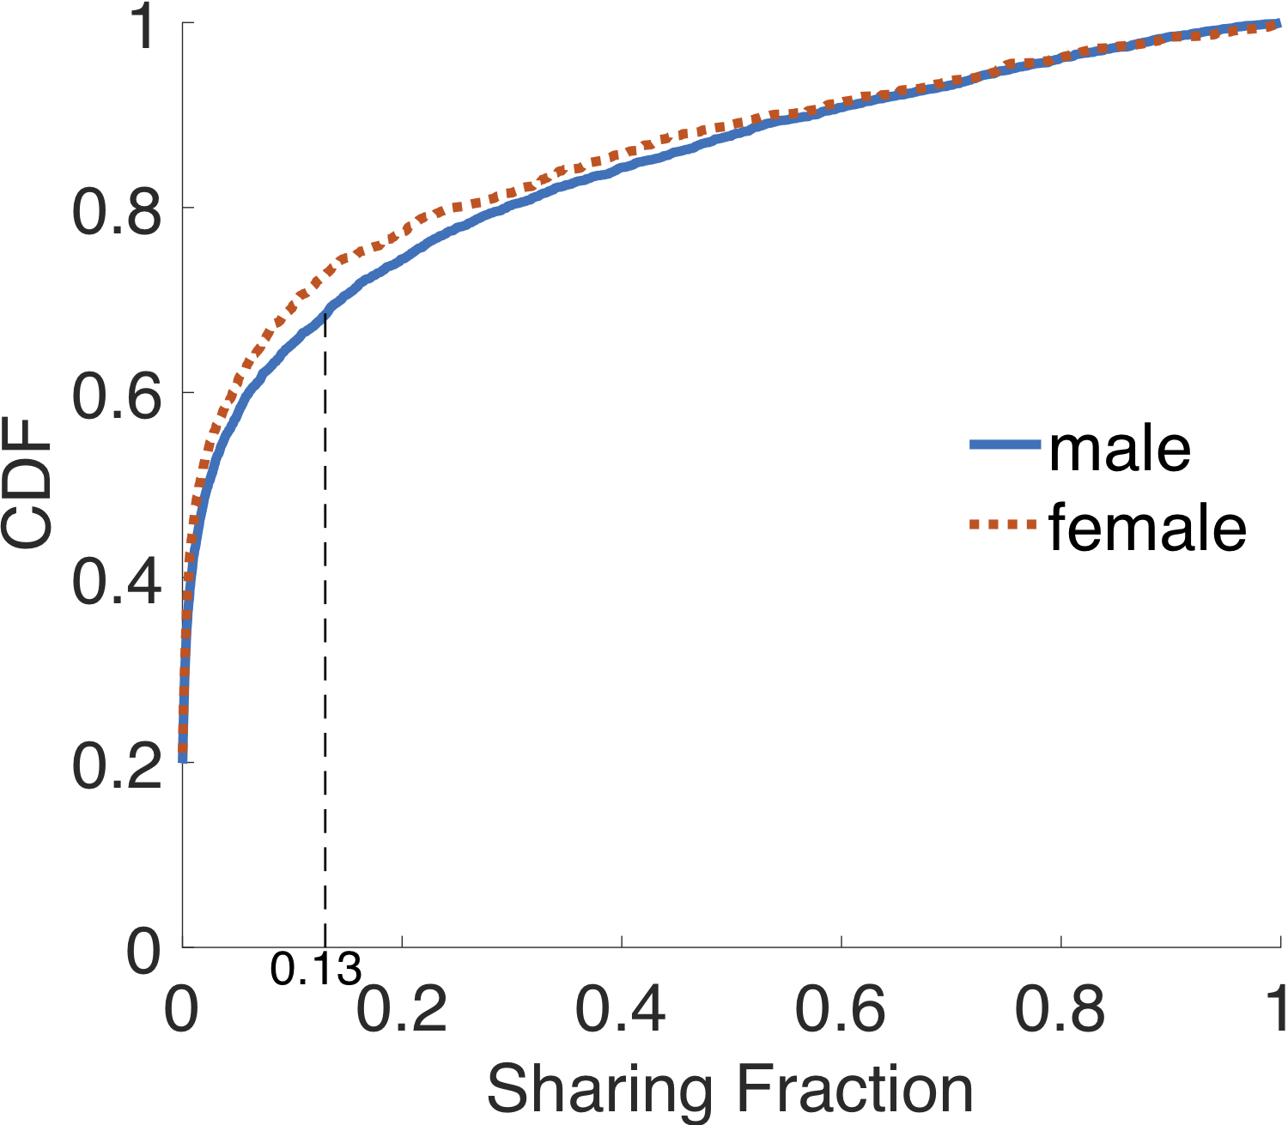
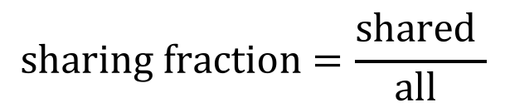
Individual Factors (Profile-related)
Sharing fraction of a user
The fraction of shared-to-Twitter check-ins in all his check-ins
Slight difference between two CDF curves
Males are more likely to share check-ins, to some extent
$$sharing fraction=\frac{shared }{all }$$
Notes:
Since different users have different amounts of check-ins, so to be fair, we define the sharing fraction.
(click) Now lets look at the relationship between
This picture shows the CDF of males and females’ sharing fractions
We can find a slight difference between
Especially, there are less males than females whose sharing fractions are less than 13%.
So we conclude that(click)
transition: Besides gender, we investigate how the number of friends will affect users’ sharing behavior.

Slide 16
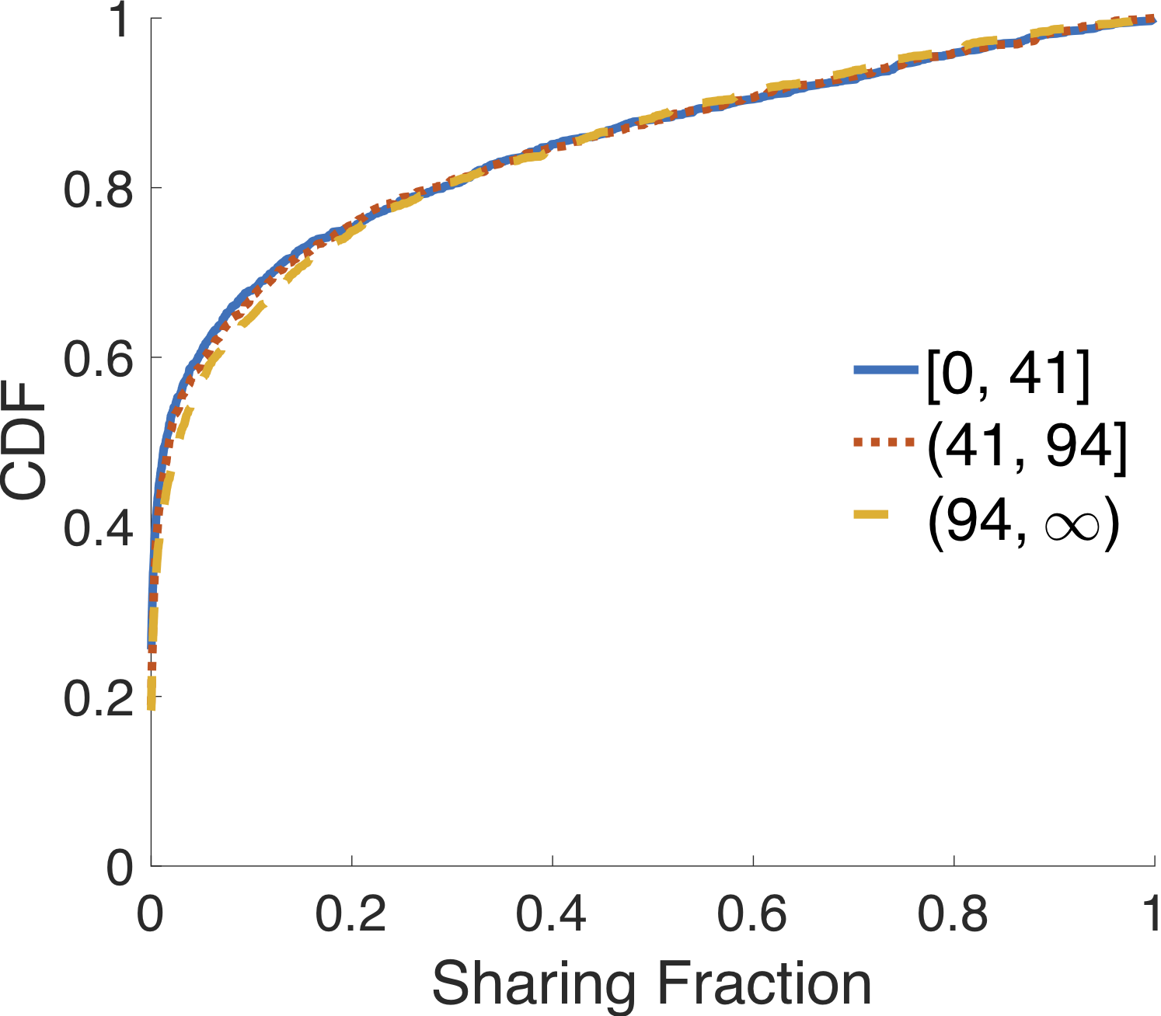
Individual Factors (Profile-related)
Divide users into 3 groups according to the number of Swarm friends
Quartile: 41 Median: 94
Almost the same curve
No relation to users’ sharing behavior
Notes:
We divide
And it can be found that (click)
It means that the number of Swarm friend has no relation to users’ sharing behavior.
transition: We also consider the number of Twitter followers

Slide 17
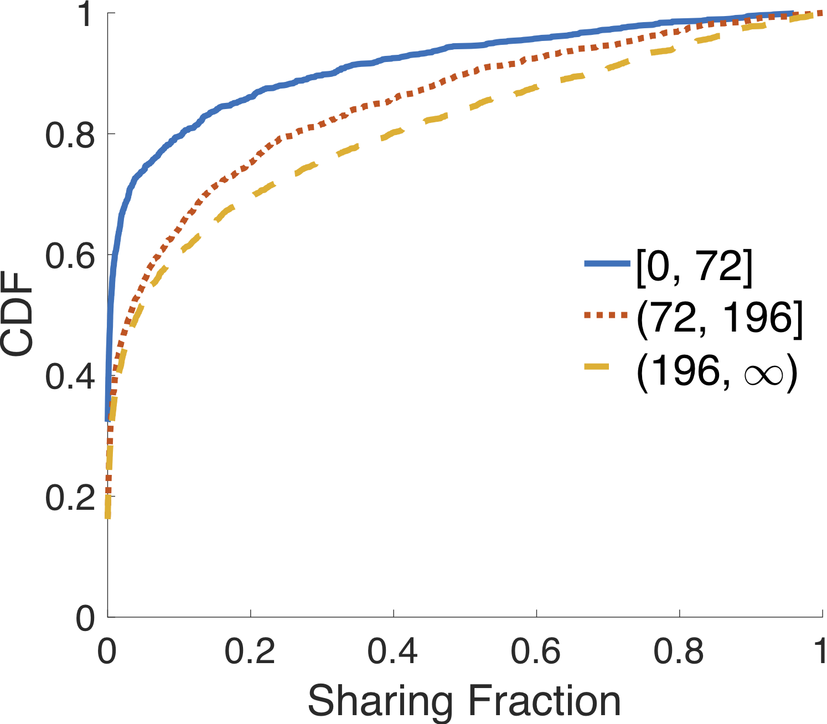
Individual Factors (Profile-related)
Divide users into 3 groups according to the number of Twitter followers
Quartile: 72 Median: 196
Totally different
More followers, More likely to share check-ins
Care more about Twitter followers
Notes:
But the results are totally different.
There are apparent differences among curves ， indicating that the users who
And comparing with Swarm friends, we know that users care more about Twitter followers when they use the sharing feature.
transition: Now we have introduced all individual factors, so let me give you a brief conclusion before we step forward.

Slide 18


Individual Factors
OSNs: know better about the usage of the sharing feature
Researchers: weak factors strong factors
 | Factors | Effect
Check-in-related | Time | Weak
 | Venue category | Weak
 | Text length | Strong
 | History factor | Strong
Profile-related | gender | Strong
 | # of Swarm friends | Weak
 | # of Twitter followers | Strong
strong factors
weak factors
Notes:
Based on the previous analysis, we have 4 factors with
(click) These results will help OSNs
(click) For researchers, it is reasonable to use shared-to-Twitter check-ins when they are working on the weak factors.
But if they use shared-to-Twitter check-ins to conduct the analysis on strong factors, they may draw biased conclusions

Slide 19
Factors
Individual factors
Check-in-related factors
Time, venue category, text length, the previous check-in’s status
Profile-related factors
Gender, the number of Swarm friends, the number of Twitter followers
Statistical analysis
Combinations of factors
Predict users’ sharing decisions with machine learning
Notes:
Now let's talk about the combinations of factors

Slide 20
Combinations of Factors
Cases
Weak factors only
Will the weak factors perform differently when they are combined?
Strong factors only
Can we predict users’ sharing decisions accurately with strong factors?
Weak factors and strong factors
How accurately can we make a prediction with all factors?
Machine Learning
Decision Tree, Random Forest, LightGBM, XGBoost
Notes:
So we consider 3 cases of combinations, the weak factors only, the strong factors only, and both of them.
transition: We construct the machine learning model and try 4 algorithms,

Slide 21
Combinations of Factors
XGBoost Performs best
Combination of weak factors can not affect users, too
Researchers: weak factors , both individually and together
Combination of strong factors is enough to predict accurately
OSNs: improve users’ experience
XGBoost Results | Accuracy | F1 | AUC
Weak | 0.66 | 0.65 | 0.73
Strong | 0.90 | 0.89 | 0.95
Weak & Strong | 0.91 | 0.90 | 0.96
Notes:
The XGBoost performs best
(click)For Case 1, all the metrics
(click)It means that even
For researchers, if they focus on weak factors, no matter individually or together, they can use shared-to-Twitter check-ins
(click) For Case2 and Case3, we found that both of them achieve high accuracy.
(click)It means that
And OSNs can improve users' experience through predict their sharing decisions accurately
transition: Finally, let me make a conclusion about this work.

Slide 22
Conclusion
Investigate factors that impact users’ sharing behavior
OSNs: know better about their sharing features
Researchers: determine the representativeness of the dataset
Factors with strong influence
Text length, history factor, gender, the number of Twitter followers
A model used to predict users’ sharing decisions accurately
Factors with weak influence
Time, venue category, the number of Swarm friends
No matter individually or in the form of combination
Shared-to-Twitter check-ins can be used for the research related to these factors or their combinations

Slide 23
Future Work
Investigate other factors and validate the conclusions on other OSNs
Conduct a survey on users’ sharing preference
Utilize deep learning models for a better prediction

Slide 24
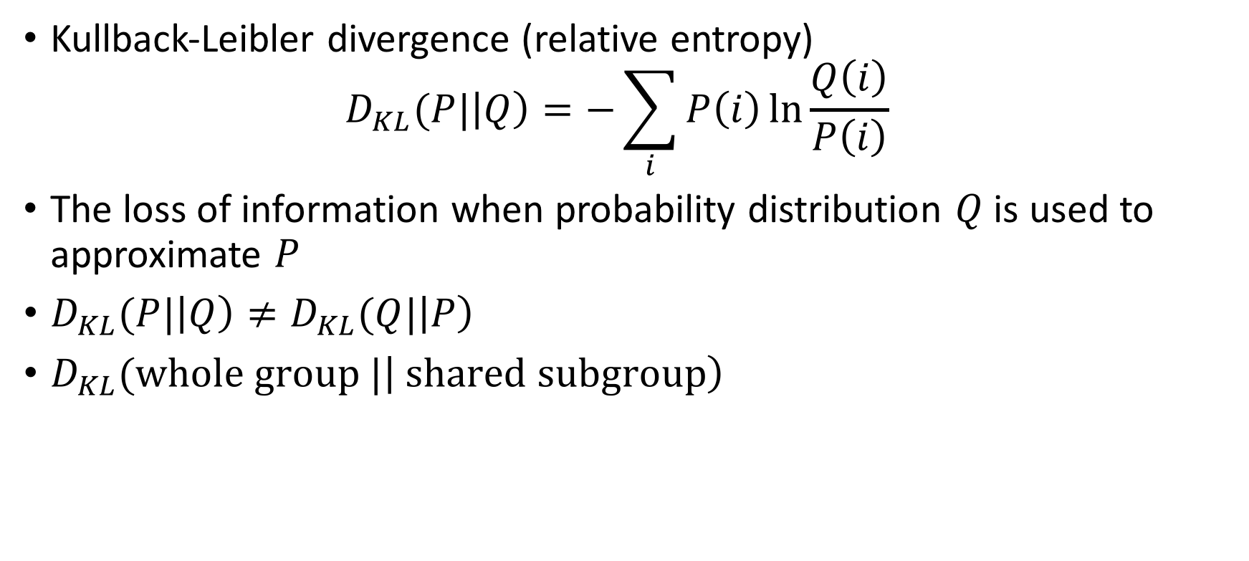
KL Divergence
Kullback-Leibler divergence (relative entropy) $D_{KL}(P|\left|Q\right)=−\sum_{i}{P\left(i\right)\ln{\frac{Q\left(i\right)}{P\left(i\right)}}}$
The loss of information when probability distribution $Q$ is used to approximate $P$
$D_{KL}(P|\left|Q\right)≠D_{KL}(Q|\left|P\right)$
$D_{KL}(whole group |\left| shared subgroup\right)$

Slide 25
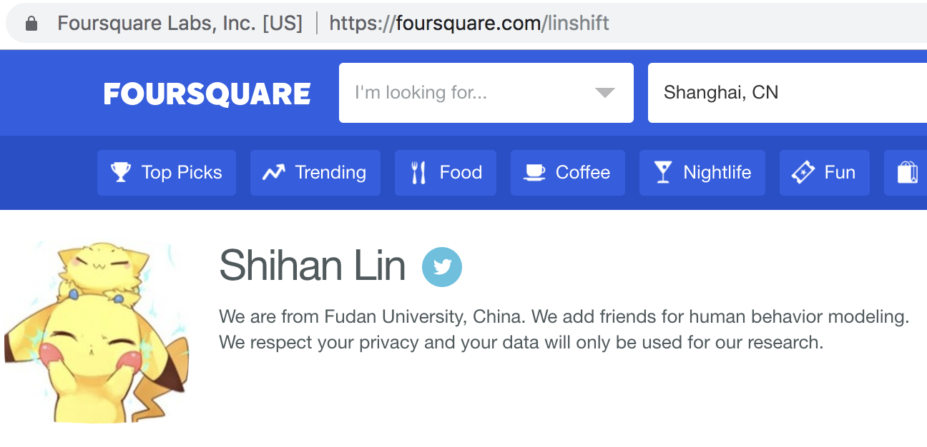
Dataset
Collect check-ins directly from Swarm
Users’ profile is public on Foursquare
Randomly select Swarm users who have linked accounts to Twitter
Send friend requests
Descriptions on our accounts’ profile
Collect friends’ check-in
Identify the shared-to-Twitter check-ins

Slide 26
Combinations of Factors
Strong factors:
time, venue category, # of Swarm friends
Weak factors:
text length, history factor, gender, # of Twitter followers
How will those weak factors perform when they are combined together?
Can we construct a model to predict users’ sharing decisions accurately with the help of those strong factors ?

