Slide 1







XFir: Accelerating New-Flow Setup on Host Servers
of a Large Cloud Network
Shihan Lin*, Shunqiao Jiang*, Liang Wang, Jian Wang, Chao Pei, Jian Zhao, Wenjun Wu, Kai Ren,
Lijun Zhuang, Qingmin Liu, Heng Yu, Sirui Li, Yibo Huang, Yifei Zhu, Yunming Xiao, Ang Chen,
Linghe Kong, Congcong Miao
Notes:
Hi everyone, I'm Shihan from University of Michigan. Today I'll talk about XFir, the new flow setup accelerating system in Tencent. This is joint work with Tencent and several universities.

Slide 2
MOTIVATION
Host servers keep scaling
One host server
350 → 500 Cores
CPU cores per host
VM
VM
VM
vCPUs
vCPUs
vCPUs
vNIC
vNIC
vNIC
200 → 400 Gbps
DPU bandwidth
VM
VM
· · ·
hundreds of VMs
vCPUs
vCPUs
vNIC
vNIC
Still 1 DPU
per host, shared by every VM
DPU — one per host
More VMs and vCPUs → more flows, more pressure on that single DPU
Notes:
Let me start with today’s cloud networks
Nowadays, a cloud server host hundreds VMs. To host VMs, the CPU have grown to 350 or 500 cores; and The DPU bandwidth are more than 200 to 400 Gbps
However, these hundreds of VMs rely on one single DPU on the server for network traffic
With more VMs and vCPUs, it comes with more flows, putting heavy pressure on the single DPU

Slide 3
BACKGROUND
Traditional “Sep-Path” Paradigm for DPU
Software Plane
CPU / SoC in DPU
Fully programmable, but slow
Slow path – New flow setup;
Offload flow states to hardware
Slow path
Software
(SoC)
CPU
DPU
Fast path
DRAM
Tables
Hardware
(ASIC / FPGA / …)
Processing Unit
SRAM
Hardware Plane
ASIC / FPGA / PS …
Fast, but limited programmability
Fast path – Accelerate subsequent packets
Packet
Offloaded Flow
Tables (OFT)
Notes:
The traditional design to support heavy workload on DPU is based on the Sep-path paradigm.
The DPU contains a Software Plane and Hardware plane
The software plane refers to the CPU or SoC in the DPU. It is fully programmable but it is slow.
The hardware plane is based ASIC, FPGA, Programmable switch. It is fast but has limited programmability.
Therefore, a Sep-Path design splits network datapath into a slow path and a fast path.
The slow path handles the new flow setup. When the initial packet gets into the DPU, it is processed by the software plane and the flow states are offloaded to the hardware plane.
Then for the subsequent packets, the DPU can handles them in the hardware plane through the offloaded states, accelerating the packet processing.
This sep-path design has provided high performance of cloud networking in the past few years.
However, nowadays,

Slide 4
PROBLEM
Slow path: a bottleneck for new-flow throughput
Customers demand 2K connections per second (CPS) per CPU core
350-core server
700K needed
500-core server
1M needed
Sep-Path
(Fornax–SIGCOMM’25)
160K CPS
Our goal: 700K – 1M CPS in the slow path
Notes:
The slow path becomes a bottleneck for new-flow throughput.
For example, customers in Tencenet demand two thousand
This means that in a 350-core server, we need 700 thousand of CPS, and in a 500-core server, we need one million CPS
However, the state of the art Sep-path design actually only provides about 160 thousand CPS
So in this work, our goal is to achieve 700k to 1 million CPS in the slow path
However, this is challenging

Slide 5
CHALLENGES
Why is it hard on cloud hosts?
Tasks in the slow path
DPU
VM
RX
Global ACL
Table
per-NIC ACL
Table
Routing
Table
VNIC
Table
Subnet ACL
Table
Global SG
Table
per-NIC SG
Table
Protocol Handshake
New flow-setup / Slow path
Connection establishment
1. Performance
Large and stateful tables
E.g, Security Groups (SG), …
2. Flexibility
Logic must keep evolving
E.g. a new filtering stage
3. Cost
> 100K hosts in a cloud region
Each host needs a DPU
Notes:
Let’s look at the tasks in the slow path.
The slow path involves looking up quite a lot tables, such as routing table, ACL, and security group tables.
Here, when we talk about new flow setup or slow path, it refers to the table lookups in the DPU, and we don’t care about the connection establishment like TCP handshake in the VM.
Overall These table lookups leads to a few challenges
First, the performance, those tables are usually Large and stateful, such as security group tables, so it leads to the performance challenge
Second, the flexibility, the processing logic must keep evolving, such as adding ..
Third, the cost, there are typically more than 100 thousands hosts in a cloud region, and each host needs a DPU. So the solution should have a low cost for applying at a large scale.

Slide 6
CHALLENGES
Why existing options fail
Option | Why it fails
Slow path in host CPUs | Host CPUs are reserved for VM tenants
Multiple DPUs per host | > 100K hosts — prohibitive cost
Slow path in an FPGA | Cannot hold the complex logics of the slow path
Slow path in a P4 ASIC | Limited resources for tables; Limited programmability
No architecture meets our goals, so we adopt new hardware architecture.
Notes:
We actually explore the existing solutions, but none of them works
For example,
we can implement slow path in the host CPUs, but host CPU are for sale, and should be reserved for VM tenants
We can also attach multiple DPUs to a host, but it is very expensive given the large number of host servers
We also try to implement slow path in FPGA or p4 switch, but their fabric cannot hold the complex logic of the slow path, and has limited programmability
Therefore, no
[<=5min]

Slide 7
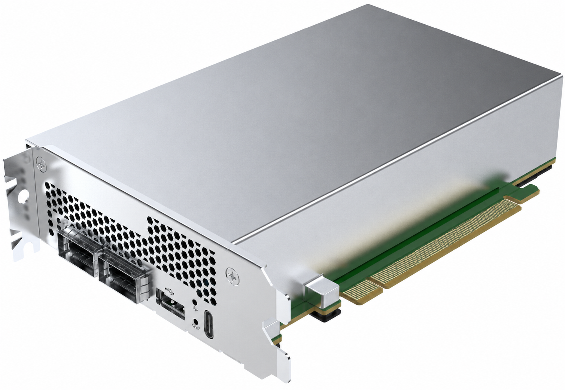
OUR PLATFORM
Xline: Next-generation DPU
CMN
DDR
DRAM
(CPU)
CPU — Software plane
6-core 2.4 GHz Arm64; Full programmability
CPU
CNP
Programmable
Pipeline
RISC-V
Coprocessor
DDR
DRAM
(CNP)
Fixed ASIC — Hardware plane
Pipeline for fast path; no programmability
TCAM & SRAM
ASIC
DDR
DRAM
(ASIC)
Pipeline
SRAM
CNP — Cloud Network co-Processor
(New hardware plane!)
Programmable pipeline; P4
32 RISC-V cores @ 1 GHz; Full programmability
Notes:
Our solution is based on the next generation DPU in Tencent, called Xline
The Xline DPU contains three components
First, it has a CPU as software plane, which has full programmability
Second, it has a Fixed ASIC hardware plane, which is actually a pipeline for fast path and is not programmable
These two components are similar to traditional DPU or SmartNIC
But Xline has a third one called CNP, Cloud Network co-Processor, which is a new hardware plane
The CNP has a programmable P4 pipeline and a RSIC-V coprocessor; The RISC-V provides full programmability

Slide 8
KEY INSIGHT
XFir: Run the entire slow path in the CNP
1. Table layout redesign
Slow path
SoC
CPU
Xline
Fast path
DRAM
Escape path
Tables
CNP
Memory
ASIC
&
OFT
Processing
Unit
2. LPM optimization
Packet
Tables
The slow path moves from the DPU's CPU to the CNP
3. CPU–CNP collaboration
Notes:
Thus, based on Xline, we proposed the system XFir, which move the entire slow path from the CPU to the CNP
Specifically, both fast and slow path goes through the ASIC and the CNP, without touching the CPU
But we use CPU for the escape path when hardware failure happens in the CNP
Specifically, we have three designs for XFir. Table layout redesign, LPM optimization, and CPU-CNP collaboration
We will go through them one by one.

Slide 9
XFir Design
Design 1: Table layout redesign
Split tables across the pipeline and RISC-V in the CNP
RX
Flow Setup Table
(FST)
Global ACL
Table
per-NIC ACL
Table
Routing
Table
VNIC
Table
Subnet ACL
Table
Global SG
Table
per-NIC SG
Table
Programmable Pipeline
RISC-V Coprocessor
Pipeline — Fast but less flexible
Small, stable, stateless
Global ACL, per-NIC ACL
RISC-V — Slow but flexible
Large or stateful
Routing, subnet ACL, SGs, …
Notes:
First, for table layout redesign,
We split tables across the pipeline and RISC-V in the CNP
As shown in the diagram,
For pipeline, it is fast but less flexible, so we put …
For RISC-V, it is slow but flexible, so we put those large tables or stateful tables here, including ….
In this table layout, we also design Flow Setup Table and version control mechanism

Slide 10
XFir Design
Design 1: Flow setup table (FST) & version control
A 3-packet TCP setup — only the first pays the full lookup chain.
SYN
Insert version
Get version
RX
Flow Setup Table
(FST)
Global ACL
Table
per-NIC ACL
Table
Routing
Table
VNIC
Table
Subnet ACL
Table
Global SG
Table
per-NIC SG
Table
Programmable Pipeline
RISC-V Coprocessor
ACK
Get version
Compare version
SYNACK
Get version
Compare version
TX
Flow Setup Table
(FST)
Global ACL
Table
per-NIC ACL
Table
VNIC
Table
Subnet ACL
Table
Global SG
Table
per-NIC SG
Table
Routing
Table
Programmable Pipeline
RISC-V Coprocessor
Notes:
These two diagram show the layout for ingress and egress traffic. They are very similar
We will show that for a TCP connection setup, it has three handshake packets, but only the first packet will go through the full lookup chain.
For SYN packet, it goes through all tables, but after that, it obtain a version number from VNIC and insert the version into the flow setup table.
Then for SYNACK, it will get version number from FST, and compare it with the one in the VNIC table, if the version numbers match, the packet will skip the rest of ACL and SG tables.
For final ACK packet, it is similar that it get the version and compare the version and skip the ACL and SG table if no changes.
This FST and version control design further improves slow path efficiency.
[<=9min]

Slide 11
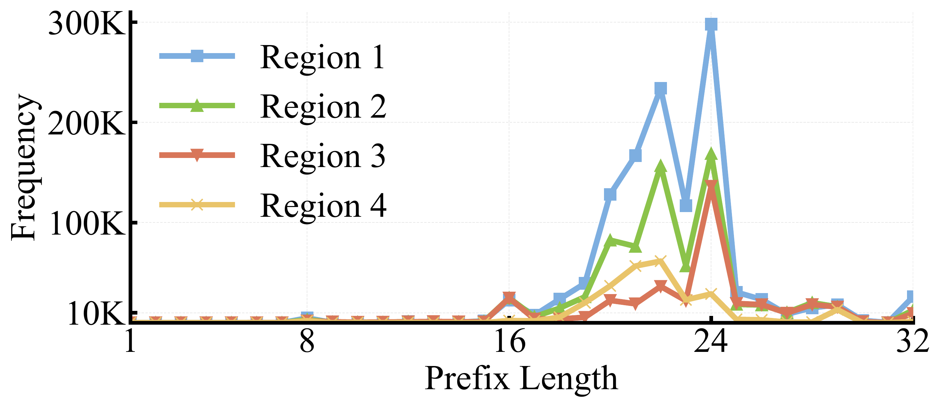
XFir Design
Design 2: Longest prefix matching (LPM) optimization
LPM is on the critical path for table lookups
Traditional Tries need many scattered DRAM accesses
Observation
> 80% of prefixes are /17–/24
→ Search long prefixes first
Notes:
Next we present that how we optimize longest prefix matching
The LPM is on the …
Traditional Tries need many
However, we optimize the LPM based on our observation of the prefix length in cloud networks.
We find that more than 80% of prefix lengths are located between 17 and 24 bits.
So our idea is to search long prefixes first

Slide 12
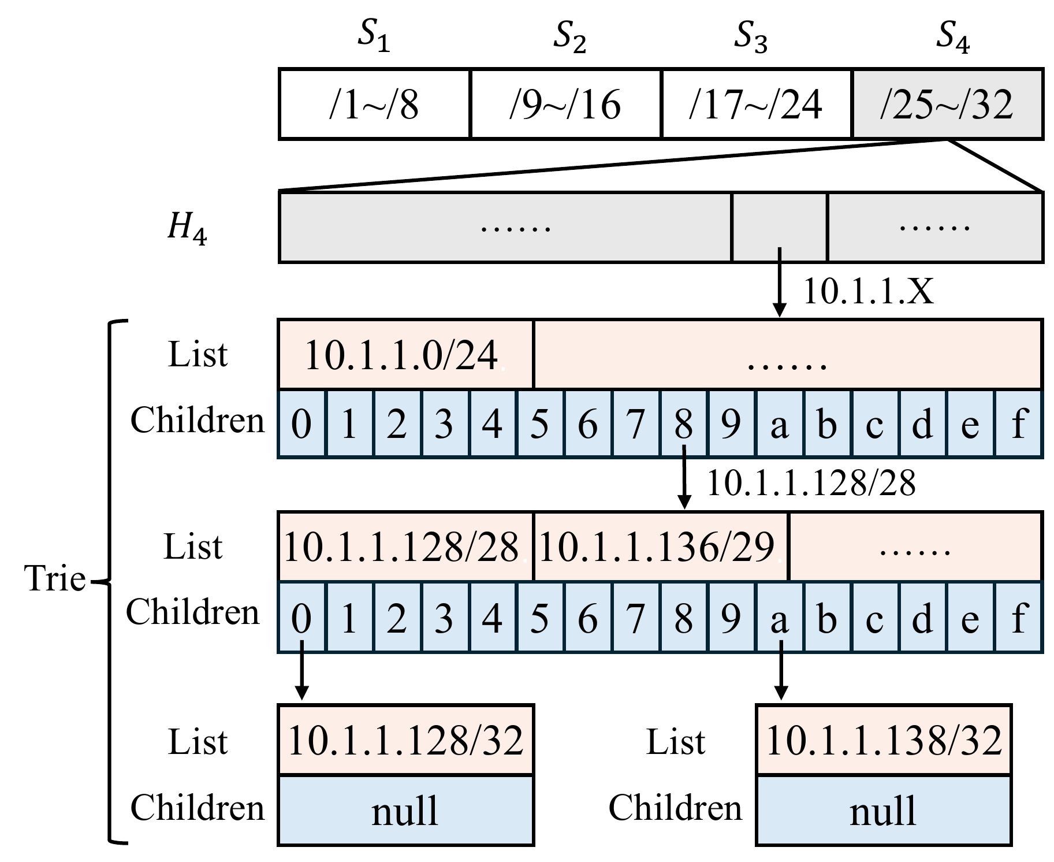
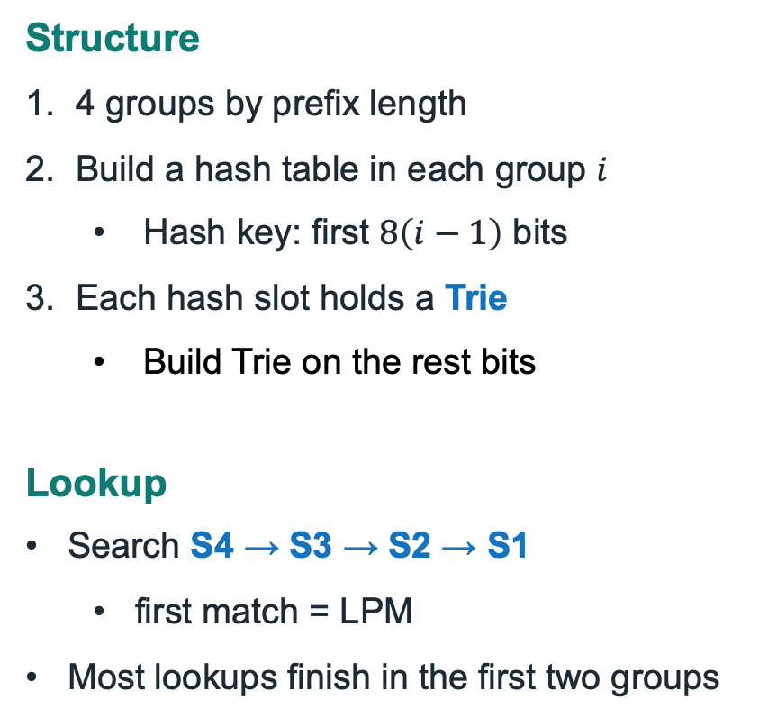
XFir Design
Design 2: Hash + Trie
Structure
4 groups by prefix length
Build a hash table in each group $i$
  Hash key: first $8\left(i−1\right)$ bits
Each hash slot holds a Trie
  Build Trie on the rest bits
Lookup
Search S4 → S3 → S2 → S1
  first match = LPM
Most lookups finish in the first two groups
Notes:
Specifically, we design an algorithm based on Hash and Trie.
We first divide the prefixes into 4 groups according to the prefix length.
Then we build a hash table in each group, using first a few bits of prefix as the hash key.
Then we build a Trie tries in each hash slot on the rest bits
For lookup algorithm,
we search the prefix in the group from longer length to shorter length.
In each group we run hashing and Trie lookup, and the first match is the LPM
Therefore, according the prefix length distribution, most lookups will finish in the first two groups, saving the lookup time.

Slide 13
XFir Design
Design 2: Fewer DRAM accesses
XFir Hash + Trie
Classic Trie
/25 – /32
0.44 µs 4 accesses
4.88 µs 33 accesses
/17 – /24
0.74 µs 7 accesses
> 80% of rules
3.55 µs 25 accesses
/9 – /16
1.04 µs 10 accesses
2.37 µs 17 accesses
/1 – /8
1.33 µs 13 accesses
1.18 µs 9 accesses
worst-case lookup time
Common prefix lengths are accelerated by >4x
Notes:
Overall, with this algorithm, we find that for 80% prefixes, the DRAM accesses reduce and the lookup time is improved by more than 4 times.

Slide 14
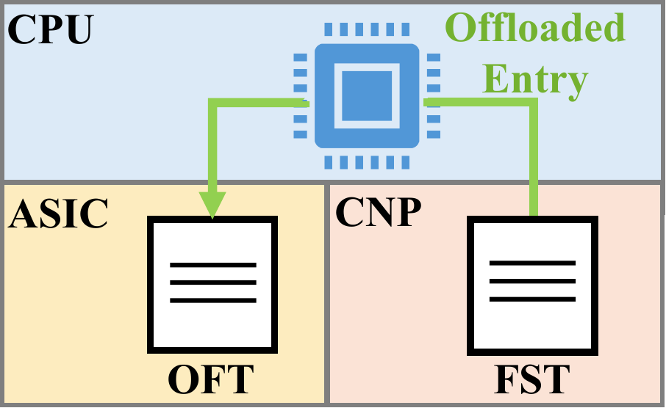
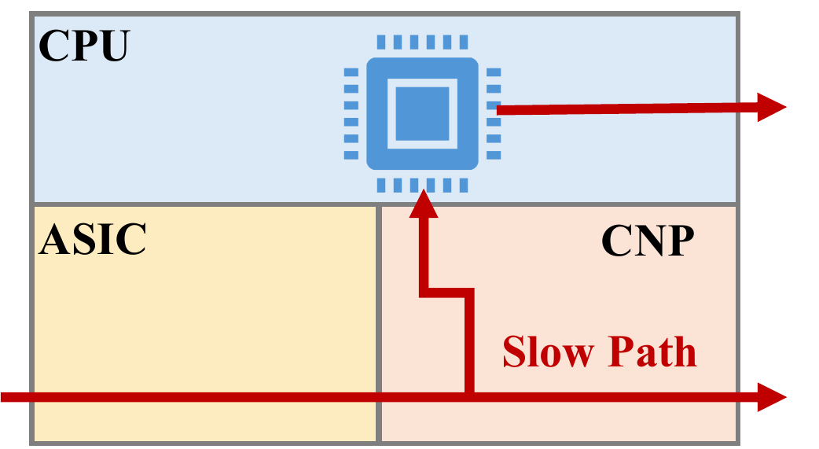
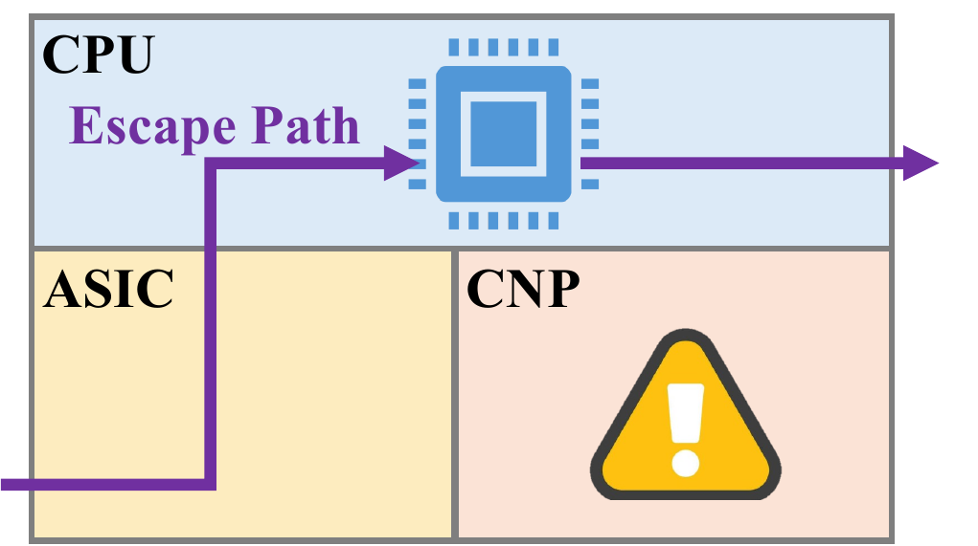
XFir Design
Design 3: CPU–CNP collaboration
CNP serves the slow path, while CPU is still useful
Control & observability
CPU polls the FST, logs the entry,
offloads it into the ASIC
Observability for debugging
Parallel flow serving
CNP and CPU handle the slow path
in parallel
Aggregate the throughput:
CNP + CPU
Escape path
On CNP failure, redirect traffic to the CPU
Lower throughput, but service stays up
Notes:
We then briefly introduce CPU-CNP collaboration.
The CNP is powerful to serves the slow path, but CPU resources are still useful. We design three collaboration mechanisms.
Firstly, control and observability, the CPU polls the FST and logs the entry, and offloads it into the ASIC.
This offloading goes through the CPU, and provides observability for error debugging.
Secondly, parallel flow serving. The CPU and CNP can handle slow path in parallel. Thus, it will aggregate the slow-path throughput
Finally, the CPU can sever as an escape path. On CNP failure, the DPU redirects traffic to the CPU for slow-path processing. The CPU offer lower throughput, but service can stay up.
We then show our evaluation

Slide 15
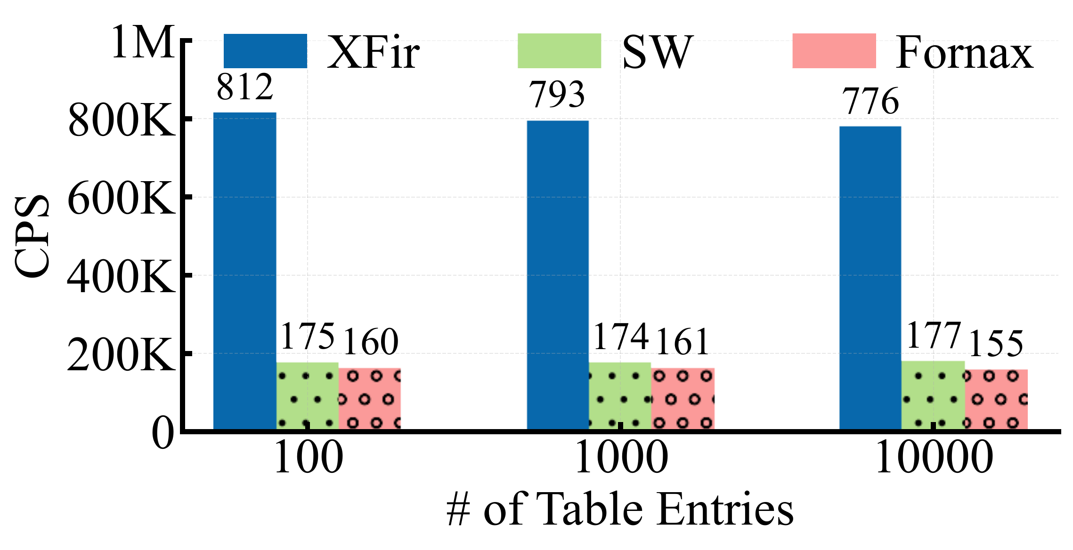
Evaluation
Slow-path throughput (CPS)
XFir: CNP of Xline
SW: CPU (Software) of Xline
Fornax: SOTA Sep-Path [SIGCOMM’25]
SW ≈ 175K, Fornax ≈ 160K, XFir ≈ 776K
CPU-CNP collaboration
  175K (SW) + 776K (XFir) = 951K
4.8x
4.8× vs. Sep-Path
New-flow setup rate across table sizes
Notes:
We then evaluate the XFir design. We first measure the slow-path throughput by CPS, connection per second
We evaluate three mechanisms,
The first one is our design of XFir by using CNP for slow path
And the SW means using Xline’s software plane
We also compare them with Fornax, which is the state of the art sep-path design
This figure shows the new-flow setup rate across table sizes.
Our results show that software and Fornax have less than 200 thousands CPS, but XFir can achieve more than 700 thousand of CPS.
Moreover, by using our CPU and CNP collaboration design of parallel serving, we can aggregate the throughput of software and XFir, achieving more than 900 thousand of CPS.
Overall, XFir achieves 4.8× the CPS of Sep-Path.

Slide 16
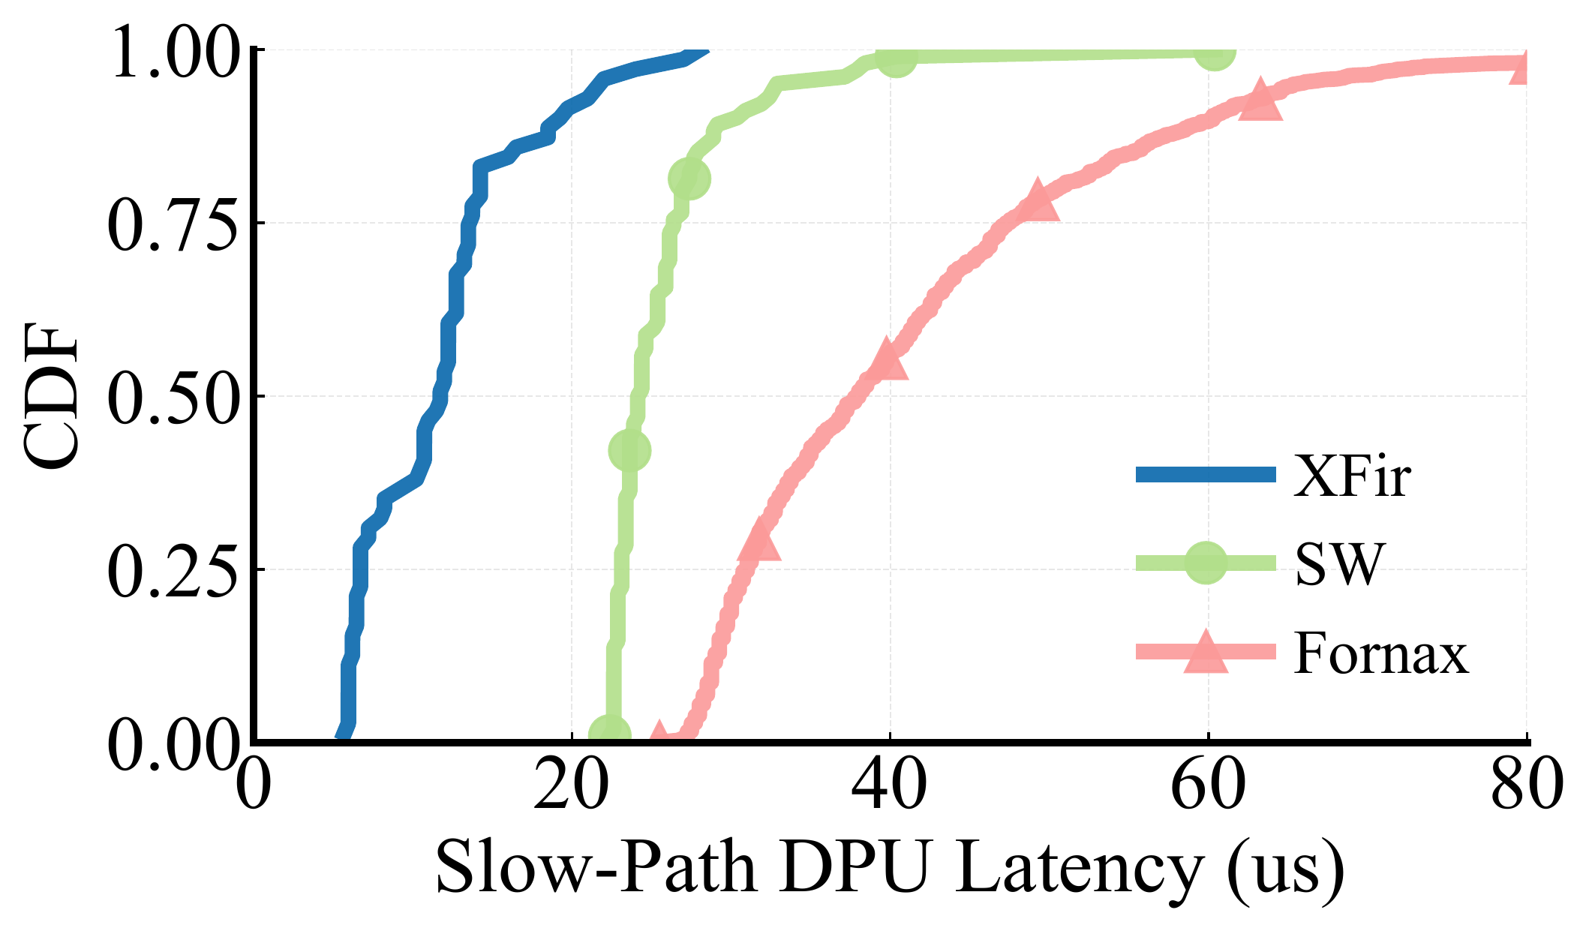
Evaluation
Slow-path latency in the DPU
XFir: CNP of Xline
SW: CPU (Software) of Xline
Fornax: SOTA Sep-Path [SIGCOMM’25]
68% off
69% off
XFir cuts down both median latency and tail latency
Notes:
We next measure the slow-path latency in the DPU
And we find that , Xfir cuts down both the median latency and the tail latency by about 68% off

Slide 17
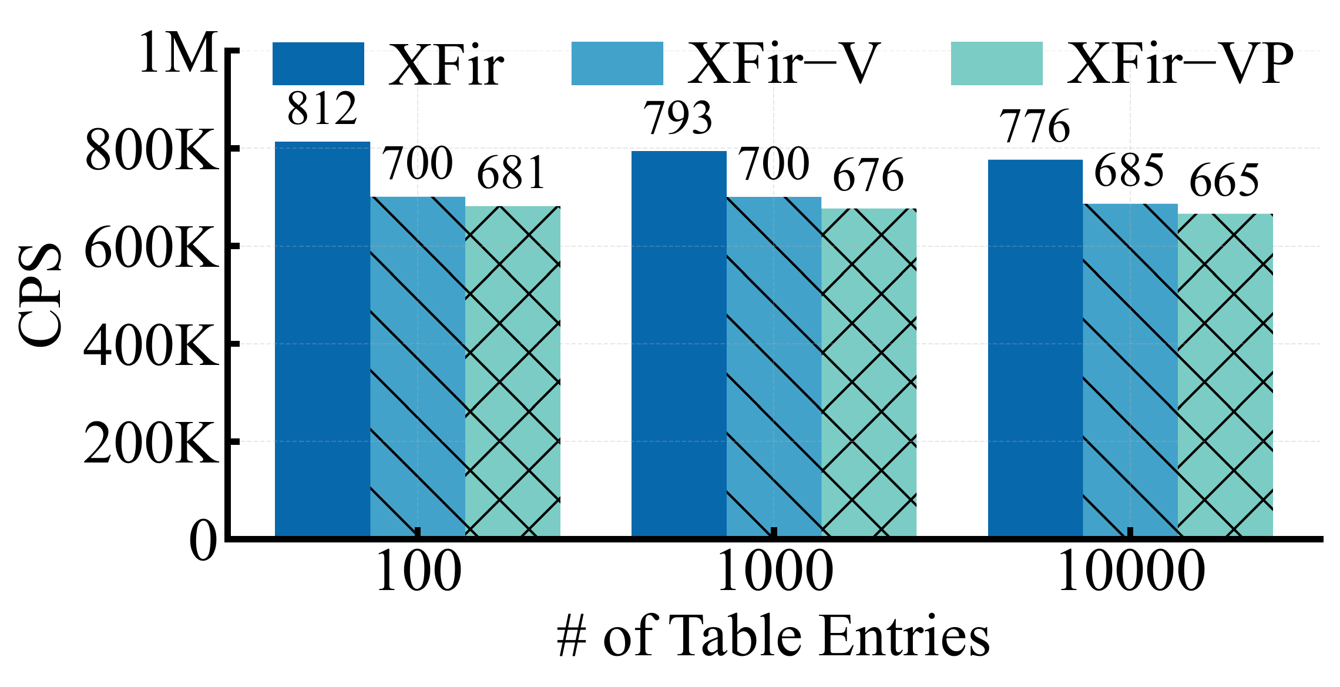
RESULTS
Ablation study of CPS
−V: no version control
−VP: no version control and all tables in RISC-V (no pipeline tables)
−V: 91K reduction
−VP: further 20K reduction
CPS with design components removed
CNP hardware provides most of the CPS improvement
Notes:
Finally we show the ablation study on our design components
We compare with XFir with mechanism. One is removing the version control, and another one also place all tables in RISC-V, leaving no tables in the CNP pipeline
In this figure, we can find that no version control reduce the CPS by 91 thousands, and removing pipeline further reduce 20 thousands of CPS
And our conclusion is that CNP hardware provides most of the CPS improvement in XFir

Slide 18
Conclusions
Takeaways
New-flow setup is the next cloud-networking bottleneck.
XFir runs the entire slow path in the CNP of our new DPU.
776K CPS (4.8×), 11.7 µs median slow-path latency.
Still one DPU per host server and fully programmable.
Thank you!
Q&A
Notes:
To wrap up, in this work,
We find that
And we keep only one DPU per host servers, it is still fully programmable.

