Slide 1
Quantifying User Password Exposure to Third-Party CDNs
Rui Xin, Shihan Lin, Xiaowei Yang
Duke University
Passive and Active Measurement Conference 2023
Notes:
Hello everyone,

Slide 2





Introduction
Content Delivery Network (CDN)
  Akamai, Cloudflare, Fastly
CDNs can observe the traffic between clients and the origin server because of HTTPS termination (CCS’16, CCS’22)
CDN
Client 1
Origin Server
Client 2
Edge Servers
Notes:
Nowadays, third-party Content Delivery Network (CDN) are very popular, such as Akamai and Cloudflare.
Websites use CDNs to speed up the web page retrieval. As the picture shows, CDN cache the web content at the edge servers near the clients
However, as mentioned in prior work

Slide 3
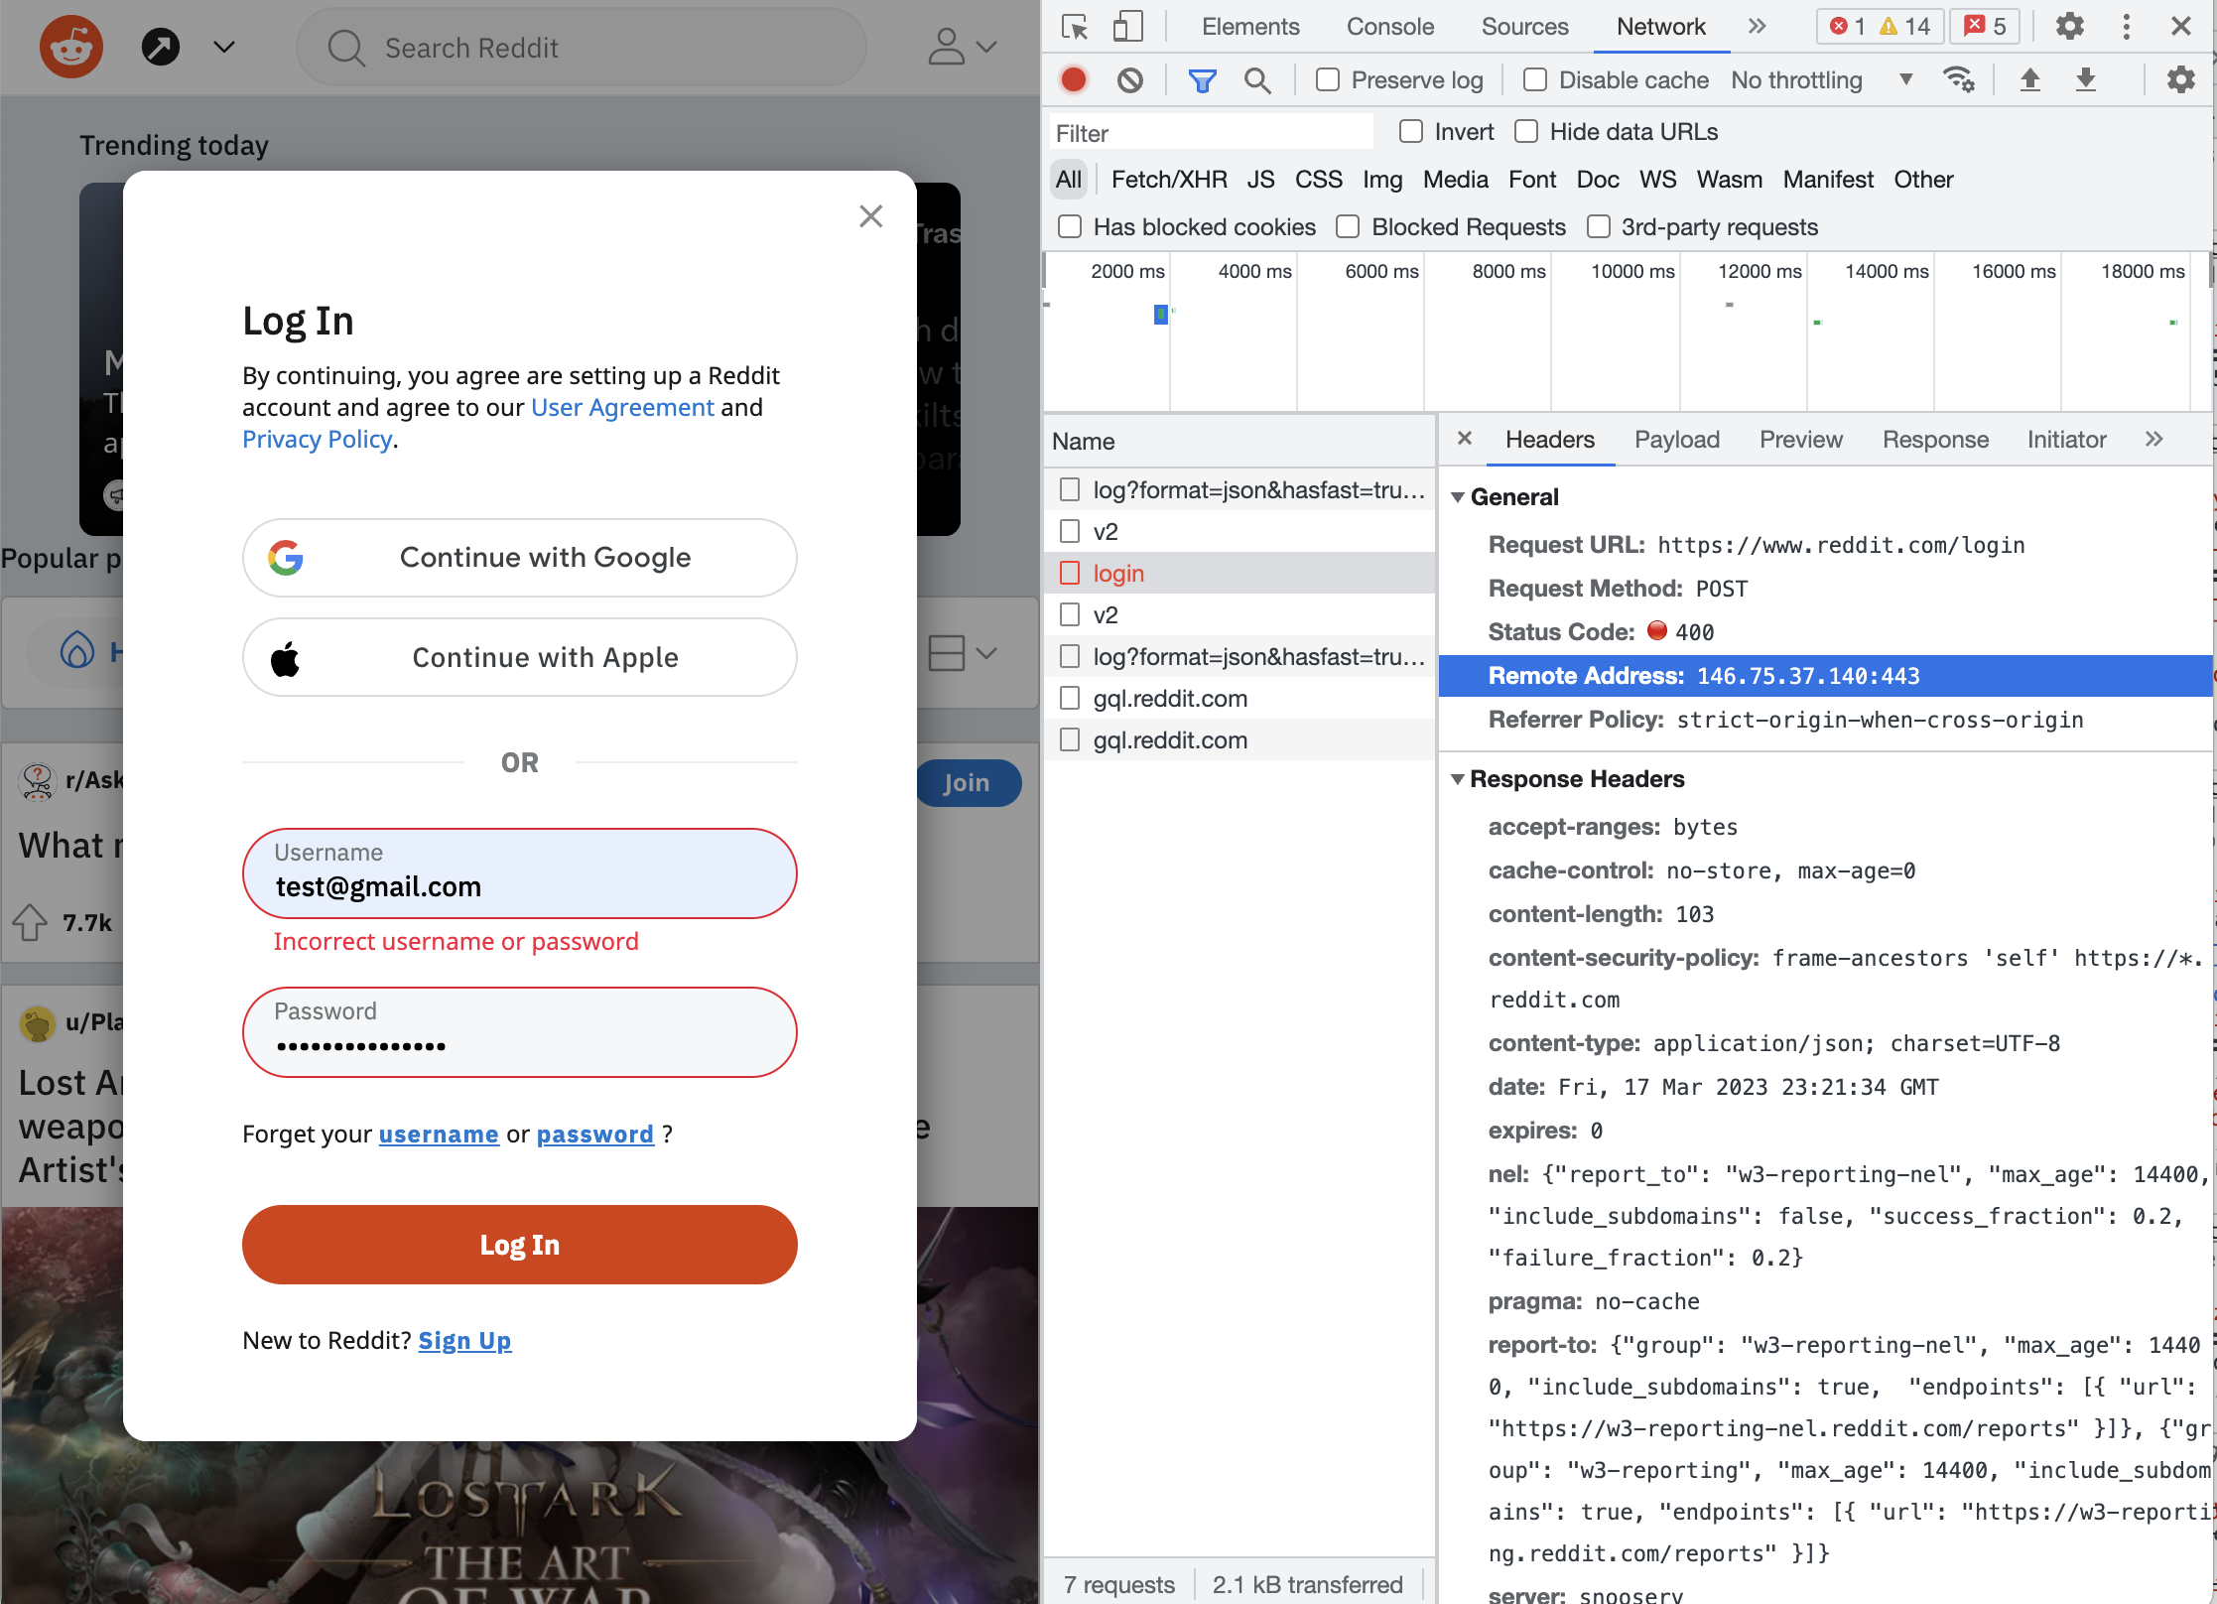
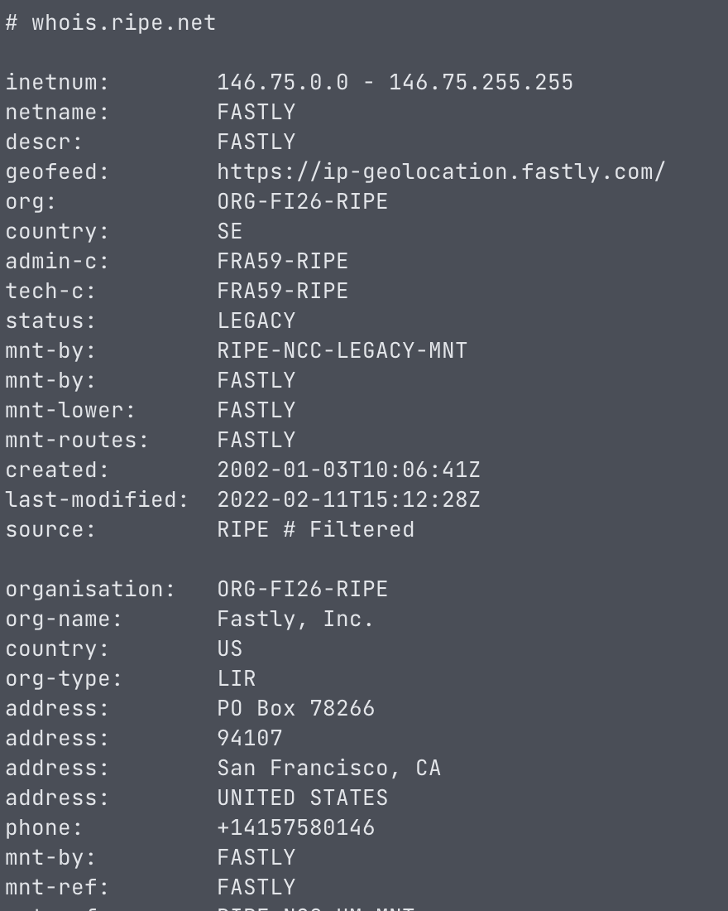
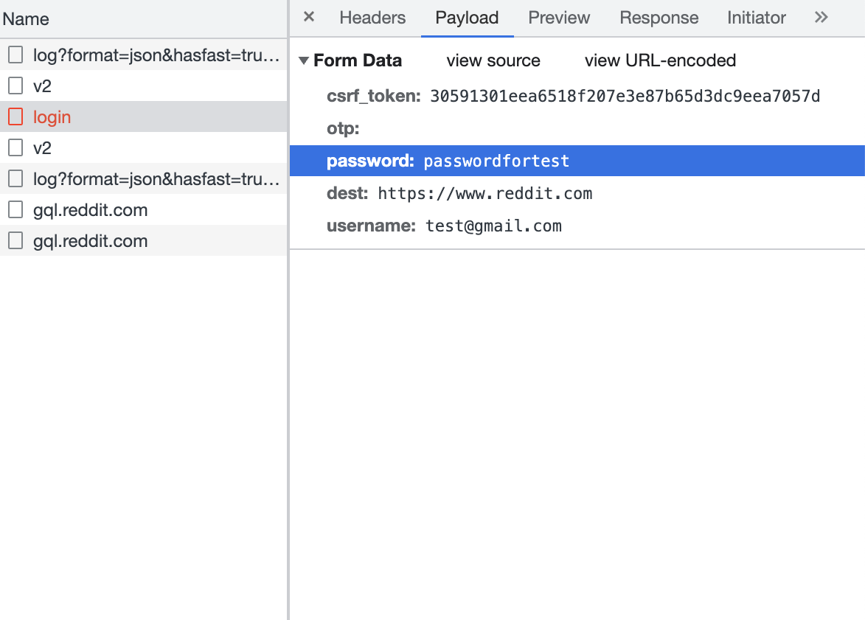
Notes:
Here is an example of the consequence of such HTTPS termination
We capture the login request when a user want to login to the reddit. We can find that the request payload contains plaintext password, and the request is sent to an IP address.
However, if we check the IP address information, we can find
It means that
Therefore, Fastly actually

Slide 4
Countermeasures in Practice
CDN bypassing
  Expose the origin server to the public (DDoS)
Client-side encryption
  Cannot prevent an active attacker who will tamper with the message
Password
Client
CDN
Origin Server
Enc(Password)
Enc(Password)
Client
CDN
Origin Server
Notes:
However, the client-side encryption is still a preliminary defense to the password exposure

Slide 5


Threat Model
Passive attackers in CDNs
  Eavesdrop, no tampering
Active attackers in CDNs
  Eavesdrop, manipulate, duplicate
Notes:
Let's start with threat model before introducing our design

Slide 6
Our work
How many websites expose user passwords to third-party CDNs?
How many websites adopt the client-side password encryption?
Notes:
To answer these two questions, we conduct a measurement on Alexa top 50 thousand websites

Slide 7
Method
Visit Alexa top 50,000 websites
Submit the fake username and password
  Automatic login framework
Collect login requests and corresponding server IP address
If the IP address belongs to a CDN
  If the login request contains plaintext password
    Password exposure to the CDN
  else
  Client-side password encryption
  else
  Probably CDN bypassing

Slide 8
Automatic Login Framework
Based on crafted heuristic rules
  See our paper for more details!
Verify on 100 websites manually
  Accuracy: (45+47)/100=92%
https://github.com/SHiftLin/PAM2023-CDNPassword
 | W/ Login | W/o Login
Login Detected | 45 | 0
Login Not Detected | 8 | 47

Slide 9
Results
About 33% of CDN-enabled websites expose passwords to CDNs
  4114 / 12451 = 33.0%
Alexa Top sites
50000
Login-detected sites
17111
CDN-enabled sites
12451
Password-exposed sites
4114
Notes:
Here are the results of our measurement

Slide 10
Distribution over Ranking

Slide 11
Distribution over CDN providers
Incapsula (66%)
  Provide a service to cache dynamic content for a short period
Cloudflare (44%)
  Originate from anycast redirection
Notes:
Then we check the distribution of websites over the CDN providers
In this figure, the x-axis is ... the y-axis is ...
the blue bars ... , the red bars ..., the number above ...

Slide 12
Cloudflare Anycast
Require transferring the DNS provider to Cloudflare
  www/login/auth.example.com is hosted by Cloudflare by default
Chi-square test
  P-value < 0.001
 | Non-Cloudflare DNS | Cloudflare DNS
W/o password exposure | 2425 | 1231
W/ Password exposure | 490 | 2182
Notes:
Here we verify the relationship between the cloudflare anycast and password exposure
When a website use Cloudflare as a CDN, to implement the anycast redirection, the websites is required to transfer its DNS provider to Cloudflare.
This will transfer all DNS records including the record of login domain such as login.example.com. So the login domain is hosted by Cloudflare by default, and the login request is sent to Cloudflare by default.
We verify this suspection by checking the number of cloudflare-enabled websites using the cloudflare DNS. Here is the statistic.
We can find that the diagonal number is much larger than the other cells, and the chi-square test shows a very small p value.
So we conclude the password exposure is highly related to usage of the cloudflare DNS and anycast

Slide 13
Distribution over Website Categories
Most retail websites expose passwords to CDN
Plenty of finance, travel, and health websites expose passwords
  Requires sophisticated protection on user data
Notes:
We also investigate
We divided websites into 14 categories.
We can find most retail websites

Slide 14
Client-side Encryption
Linear CDF means no bias in the ranking
Top websites tend to encrypt the passwords
The high peak: www.kfc.tmall.com, www.lenovo.tmall.com
Overall, less than 17% of websites encrypt the passwords
Notes:
Next, we take a look on the usage of client-side encryption related to ranking
In this figure the x axis is … , the y axis is …
The figure shows a linear CDN, it means that our data has no bias in the ranking
So we divided the websites into 100 ranking interval and interval include 500 websites. We then calculate the percentage of password-exposed websites in the interval.
In this figure the x axis is … , the y axis is
We have two observations in this figure

Slide 15
Discussion
Need further research on solutions
  OAuth, PAKE
  mcTLS (SIGCOMM’15), Phoenix (USENIX’20), InviCloak (CCS’22)
Users can use two-factor authentication
Website should adopt client-side encryption
  Prevent passive attackers who do not tamper with the message
CDN should involve in deploying advanced solutions
Hope to raise the awareness of such a password exposure vulnerability
Notes:
Based on our study
OAuth : single point of failure
PAKE: need trust on the first use

Slide 16
Conclusion
33% of CDN-enabled websites expose user passwords to CDNs
Less than 17% of websites adopt client-side password encryption
Cloudflare and Incapsula observes passwords from a large portion of their customers
Our automatic login framework is available at
  https://github.com/SHiftLin/PAM2023-CDNPassword
Thank you!
Q&A

