Slide 1







Cost-Effective and Reliable Global Internet Peering with Programmable Switches
Congcong Miao, Zhiyi Yao, Jianchao Lv, Jinglin Wang, Shihan Lin, Xinyi Zhang, Yunming Xiao, Wei Guo, Jiwu Bu, Yachen Wang, Xianneng Zou, Yong Jiang, Marco Canini, Gaogang Xie

Slide 2
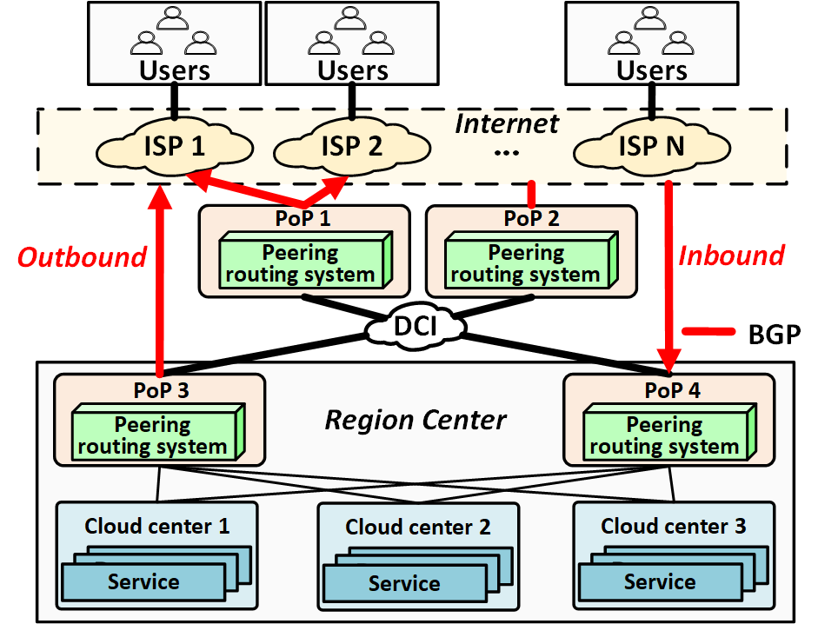



Cloud Peering
Internet Peering Edge: The Gateway Between Cloud and ISP
Global PoP Deployment
Standardized Routing: BGP
Traffic Direction Management
•Outbound
•Inbound
Notes:
Let's start with the background. Cloud peering edge is the critical gateway between cloud services and global ISPs.
Tencent deploys PoPs worldwide,
use BGP for inter-domain routing, and manage two directions of between Internet and cloud.
This edge carries terabits-scale traffic every day, so its performance, cost, and security are vital for cloud providers

Slide 3


Two Traditional Architectures
Router-based
Host-based
(Espresso [SIGCOMM’17])
Description: Commercial routers.
Pros: High performance, excellent stability, and reliability.
Cons: limited flexibility.
Description: Commodity servers.
Pros: Rapid prototyping and easy customization.
Cons: Vulnerable to DDoS attacks; scalability bottlenecks.
Notes:
There are two traditional peering architectures. The first is router-based, using commercial high-end routers. It’s stable and high-performance, but it is inflexible—adding a new feature takes months. The second is host-based, like Google’s Espresso, using commodity servers. It’s flexible for customization, but vulnerable to DDoS and hard to scale.

Slide 4
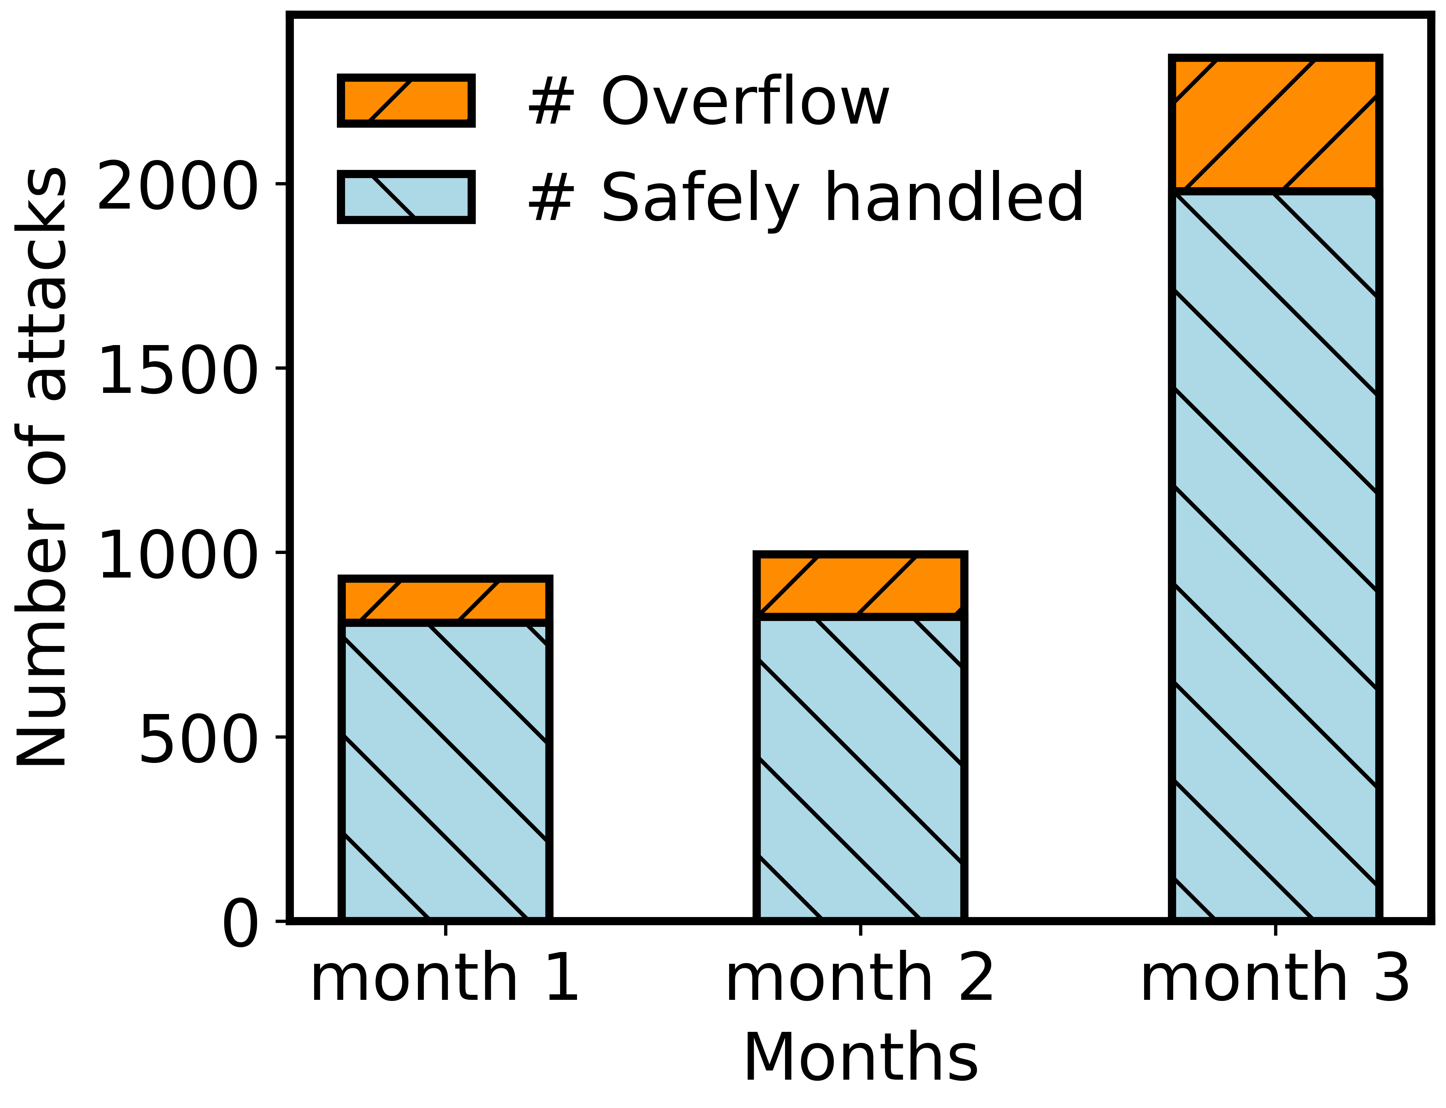
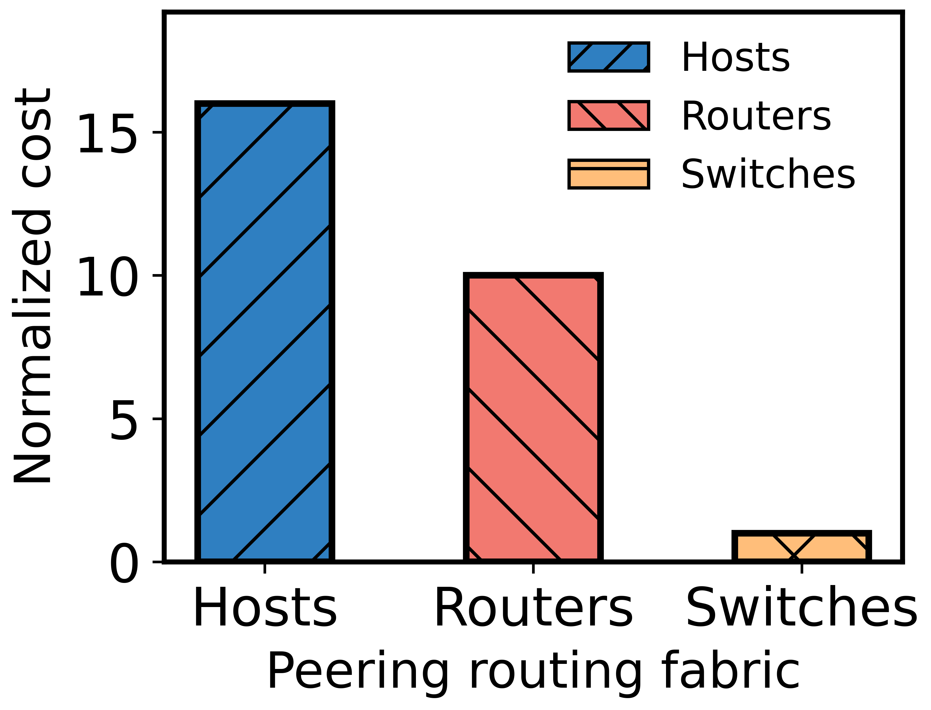



Motivation: Three Critical Pain Points
DDoS Flood
High Cost
Slow Convergence
Notes:
From our production data, we found three fatal pain points. First, DDoS floods: over 4,200 attacks in 3 months, 15.5% of them overload host processing capacity. Second, extremely high cost: host servers cost 1.6 to 16 times more than routers or switches. Third, slow convergence: traditional systems take minutes to update millions of routes in our cloud upon failure. All these problems mean we need a brand-new peering design

Slide 5
Motivation: Three Critical Pain Points
4,200 attacks in 3 months, with 15.5% overflows
DDoS Flood
High Cost
Slow Convergence
Notes:
From our production data, we found three fatal pain points. First, DDoS floods: over 4,200 attacks in 3 months, 15.5% of them overload host processing capacity. Second, extremely high cost: host servers cost 1.6 to 16 times more than routers or switches. Third, slow convergence: traditional systems take minutes to update millions of routes in our cloud upon failure. All these problems mean we need a brand-new peering design

Slide 6
Motivation: Three Critical Pain Points
1.6–16× more than routers or switches
4,200 attacks in 3 months, with 15.5% overflows
DDoS Flood
High Cost
Slow Convergence
Notes:
From our production data, we found three fatal pain points. First, DDoS floods: over 4,200 attacks in 3 months, 15.5% of them overload host processing capacity. Second, extremely high cost: host servers cost 1.6 to 16 times more than routers or switches. Third, slow convergence: traditional systems take minutes to update millions of routes in our cloud upon failure. All these problems mean we need a brand-new peering design

Slide 7



Design Principles
Reliability
Cost-effectiveness
Fast Convergence
Flexibility
Resilient to DDoS attacks.
Low hardware cost using commodity switches.
Seconds-level route convergence.
Support application-aware routing policies.
Notes:
Our design follows four key principles: reliability against DDoS, cost-effectiveness with low hardware cost, fast convergence in seconds, and flexibility for application-aware routing. These principles guide the entire design.

Slide 8
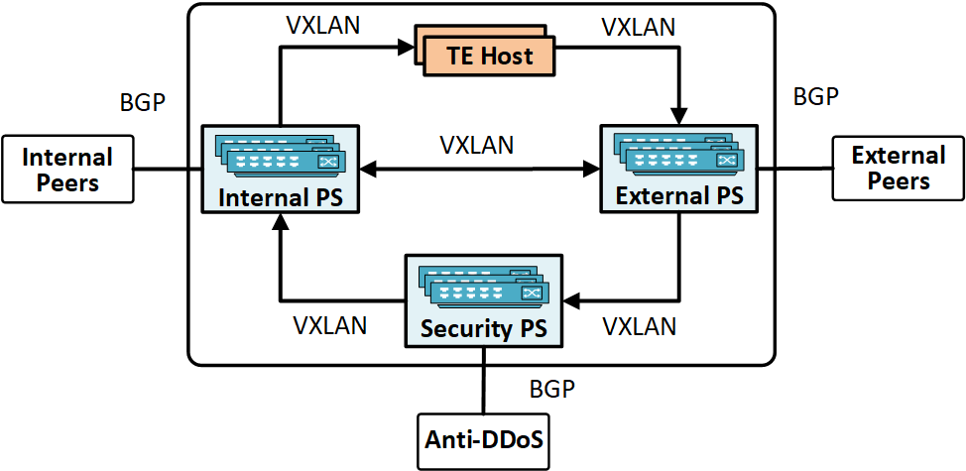
Janus Overview
A Hybrid Architecture:
Programmable Switch + Host
Core Idea: Switch-first, host-assisted peering.
Switches: Forward the majority of traffic (hot routes) for high performance and low cost.
Hosts: Handle fine-grained policies (cold/TE routes) for flexibility.
Notes:
So we propose Janus: a switch-first, host-assisted hybrid design. Programmable switches peers with neighbor AS. they forward the majority of traffic for high performance and low cost, while host servers handle fine-grained traffic engineering policies.
We use three types of Programmable switches: external, internal, and security, working together with hosts and anti-DDoS clusters.

Slide 9
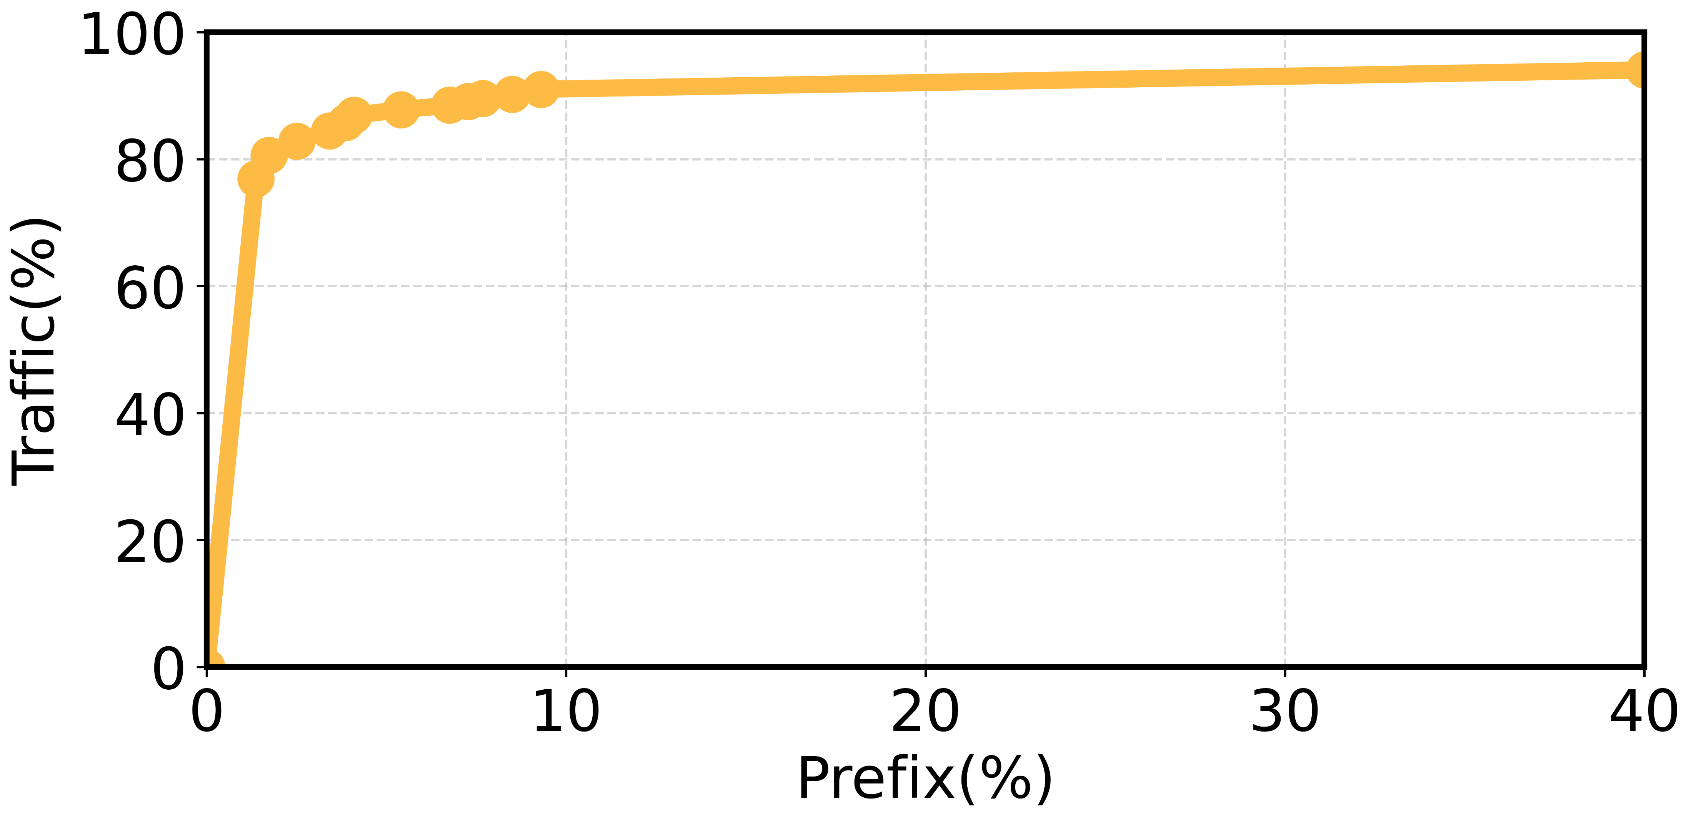
Key Observation
A small number of routes carry most traffic.
80%
of traffic is carried by
Top 1.7% routes
90%
of traffic is carried by
Top 7.6% routes
This observation enables our “hot route offloading” design.
Notes:
Before diving into details, here’s our key observation from two years of production measurements: traffic is highly skewed. Only 1.7% of routes carry 80% of traffic, and 7.6% carry 90%. This is the foundation of our hot-route offloading design.

Slide 10
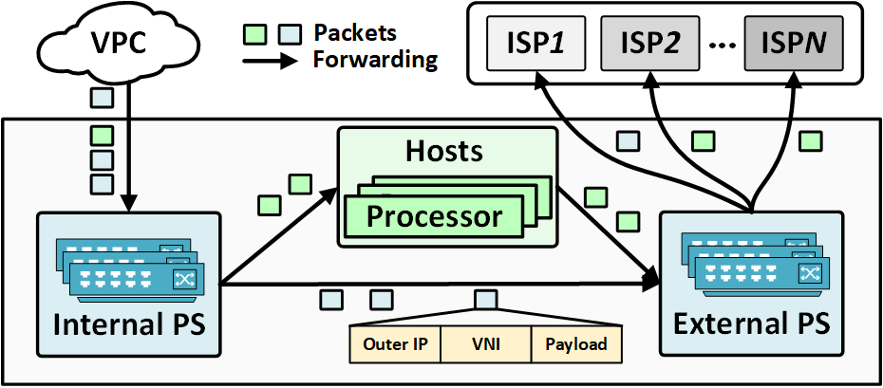
Outbound Traffic Offloading
Hierarchical Traffic Dispatch
• Internal PS: Route traffic to hosts or external PS.
• External PS: Forwards traffic to peers.
• Host: Handles cold traffic or routes requiring TE.
Asymmetric FIBs
• Switches: Store only hot, high-frequency routes.
• Hosts: Maintain the full routing table to handle the long tail of cold routes.
Notes:
First, for outbound traffic offloading, we design a hierarchical traffic dispatch module: internal peering switch receives cloud traffic, forwards hot routes directly to external switch, and sends cold or TE-required traffic to hosts.
The external PS forwards traffic directly
The host handles cold traffic or routes requiring TE
We use asymmetric FIBs: switches store small-scale hot routes, hosts store full Internet routes.
This way, we maximize switch utilization and minimize host count.

Slide 11
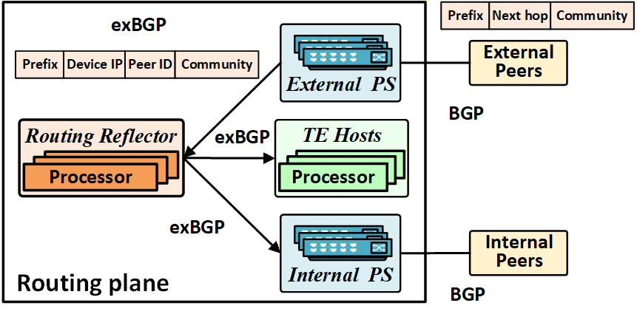



exBGP: Routing Synchronization
Extend BGP for Intra-system Sync
Goal
Guarantee global consistency of routing information.
Extensions
Added Device IP and Peer ID attributes to standard BGP update.
Mechanism
A dedicated Routing Reflector (RR) aggregates and broadcasts state updates to all switches & hosts.
Notes:
To synchronize routes across all devices, we extend BGP to exBGP, adding device IP and peer ID attributes.
A routing reflector broadcasts updates to all switches and hosts, ensuring global routing consistency and enabling fast convergence

Slide 12
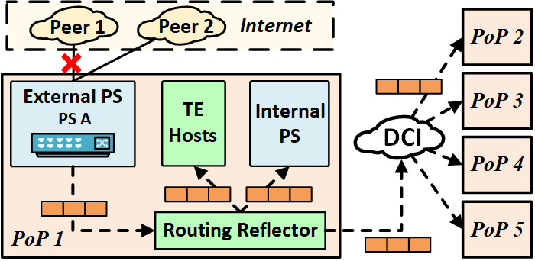


Fast Convergence: Remote Link Sense
Failure Notification via Routing Reflector
First-hop PS Detection
Detects a link failure and immediately reports it to the Routing Reflector (RR).
Batched Route Update
Organizes routes by device IP and link,
and locates affected routes quickly during a failure
Cached Route Calculation
Caches the results of community attributes and reuses them during route updates
Notes:
Janus will detect a link failure and immediately reports to RR. It then broadcast to every devices through our extended BGP protocol.
Moreover, traditional systems update routes one by one, taking minutes. We use two techniques to optimize that
One is batched route update
Another one is

Slide 13

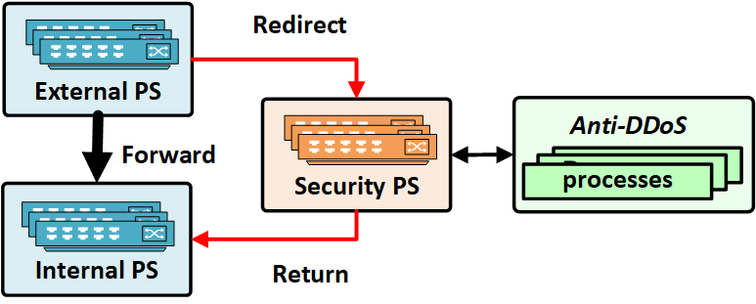

Inbound DDoS Mitigation
Switch-only Inbound Forwarding
Bypass vulnerable hosts for all inbound traffic.
External PS → Security PS → Anti-DDoS cluster.
3-Layer DDoS Scrubbing: Prefix blackholing (External PS)→ ACL filtering(Security PS) → Deep packet inspection (Anti-DDoS cluster)
Notes:
For security, we redesign inbound traffic processing: all inbound traffic bypasses hosts, handled entirely by switches.
We use a three-layer DDoS mitigation:
external PS for prefix blackholing,
The traffic with matched prefix is redirected to security ps for ACL filtering
The traffic passes the ACL will be redirected to anti-DDoS cluster for deep inspection.
This three layer DDoS mitigation protects hosts from DDoS.

Slide 14
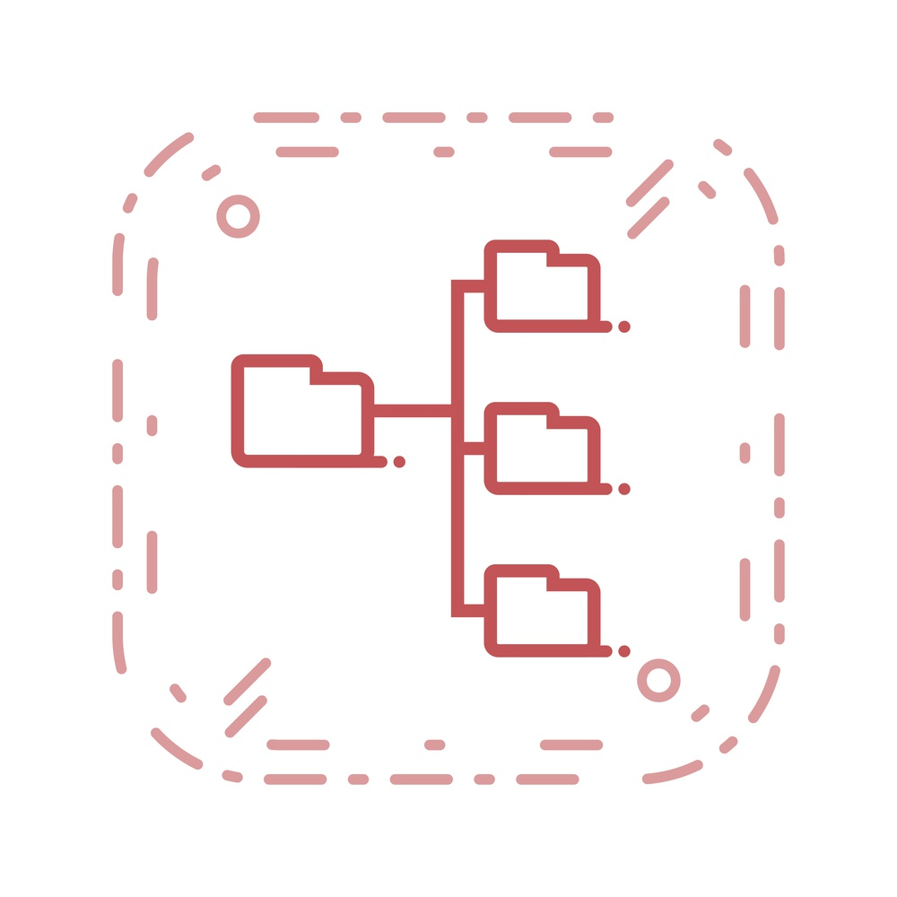
Evaluation: Testbed Setup
Host Node (Sink)
Hardware & Software: Commodity Server (48-core CPU) with DPDK-based L3 router.
Forwarding performance of the host to 120Gbps.
Switch Node
Hardware Model: Broadcom Trident3
Key Specifications:
• On-board 4-core x86 CPU for control plane
• 3.2 Tbps total switching capacity
• 320K TCAM entries for table lookups
Notes:
We built a testbed identical to our production environment: programmable switch with Broadcom Trident3, 4-core CPU, 320K entries;
host server with 48-core CPU and DPDK, safe forwarding threshold at 120Gbps.

Slide 15
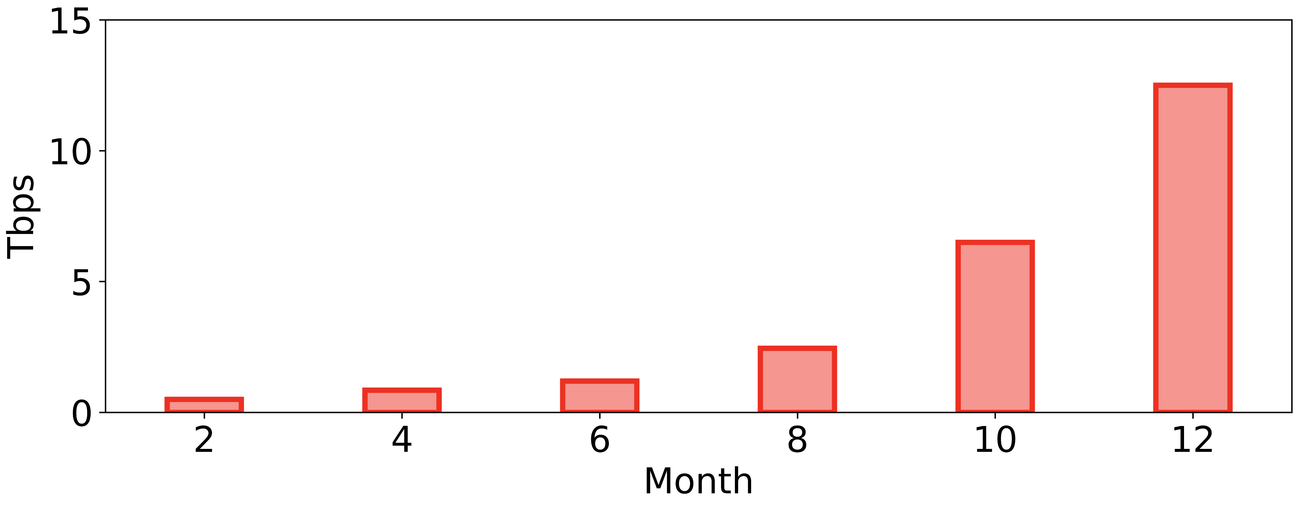
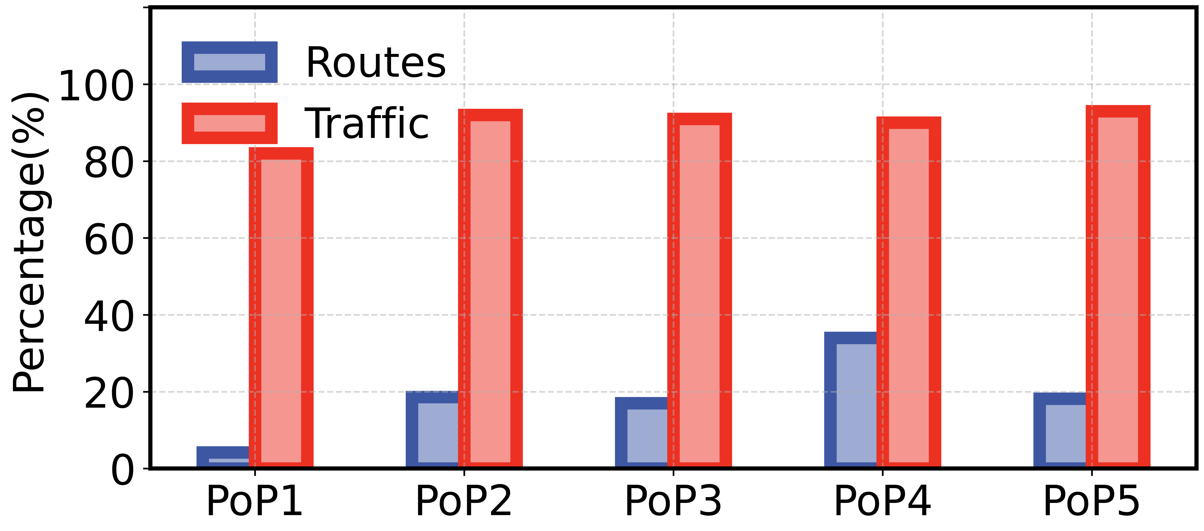

Result: Traffic Offloading
Traffic carried by Janus
grew 3$×$ for last 4 months
<10% of routes carry ≥82% of traffic
Notes:
In the past four months, we observe the traffic carried by Janus grew by 3 times. Within it, less than 10% of routes are offloaded to switch ASICs, but they carry more than 82% of total traffic, validating our core traffic-skewness observation.

Slide 16
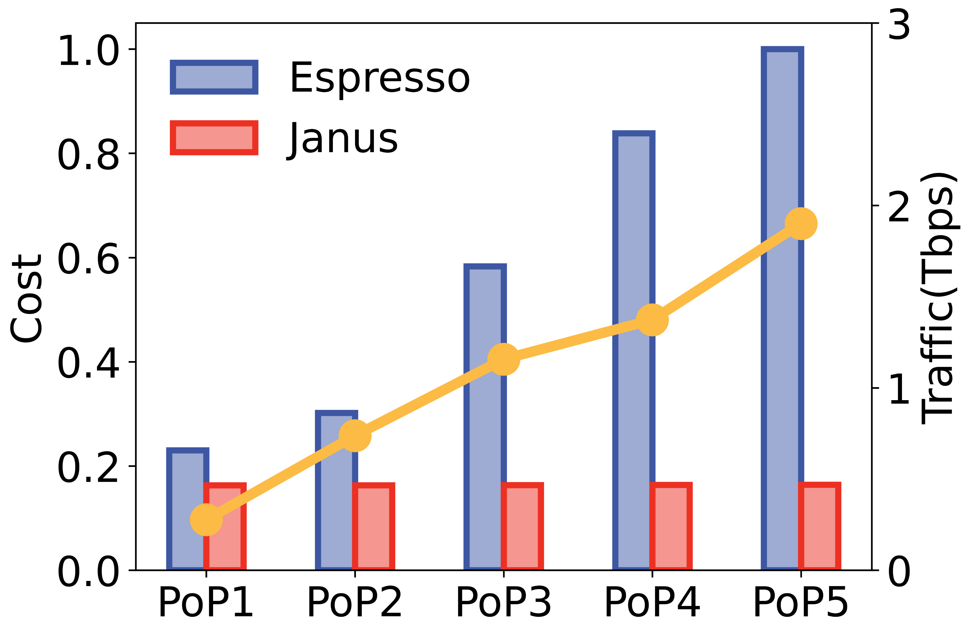
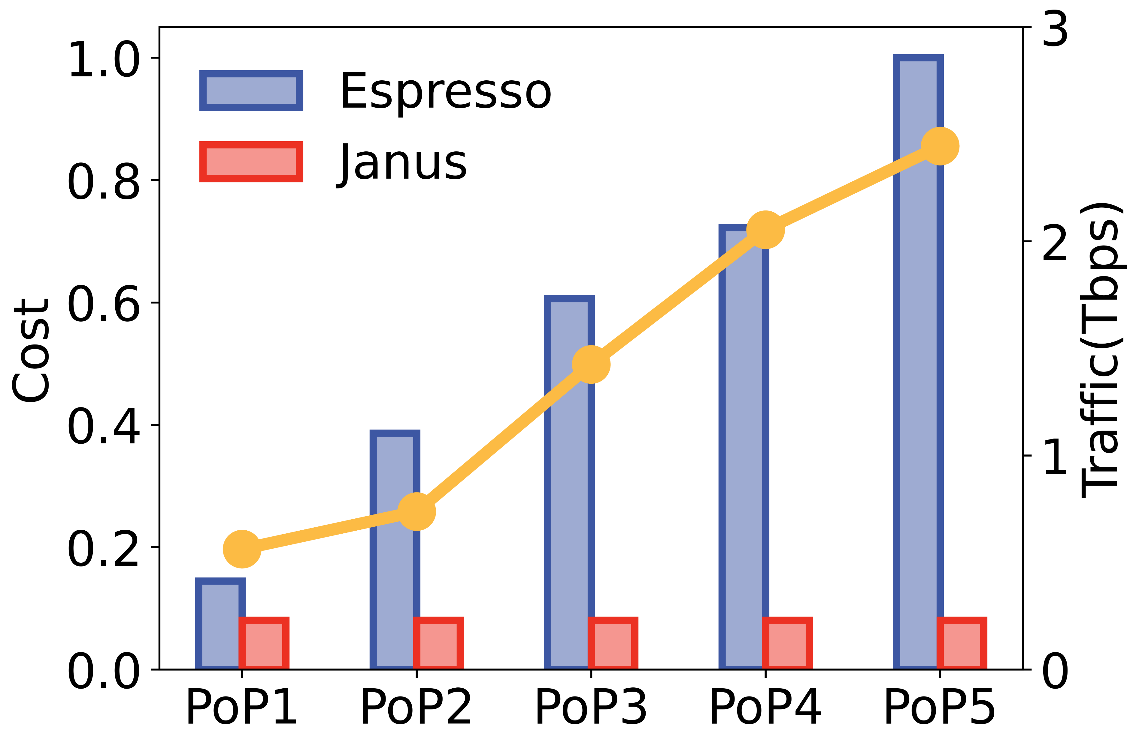
Result: Cost Saving
Janus can reduce the average network hardware cost by 78%
Outbound Traffic
Up to 84% cost reduction compared to traditional host-based processing solutions.
Inbound Traffic
Up to 90%+ cost reduction achieved by completely bypassing host servers.
Notes:
Janus cuts average hardware cost by 78%, with up to 84% reduction for outbound traffic and over 90% for inbound traffic, thanks to full switch offloading for incoming flows

Slide 17
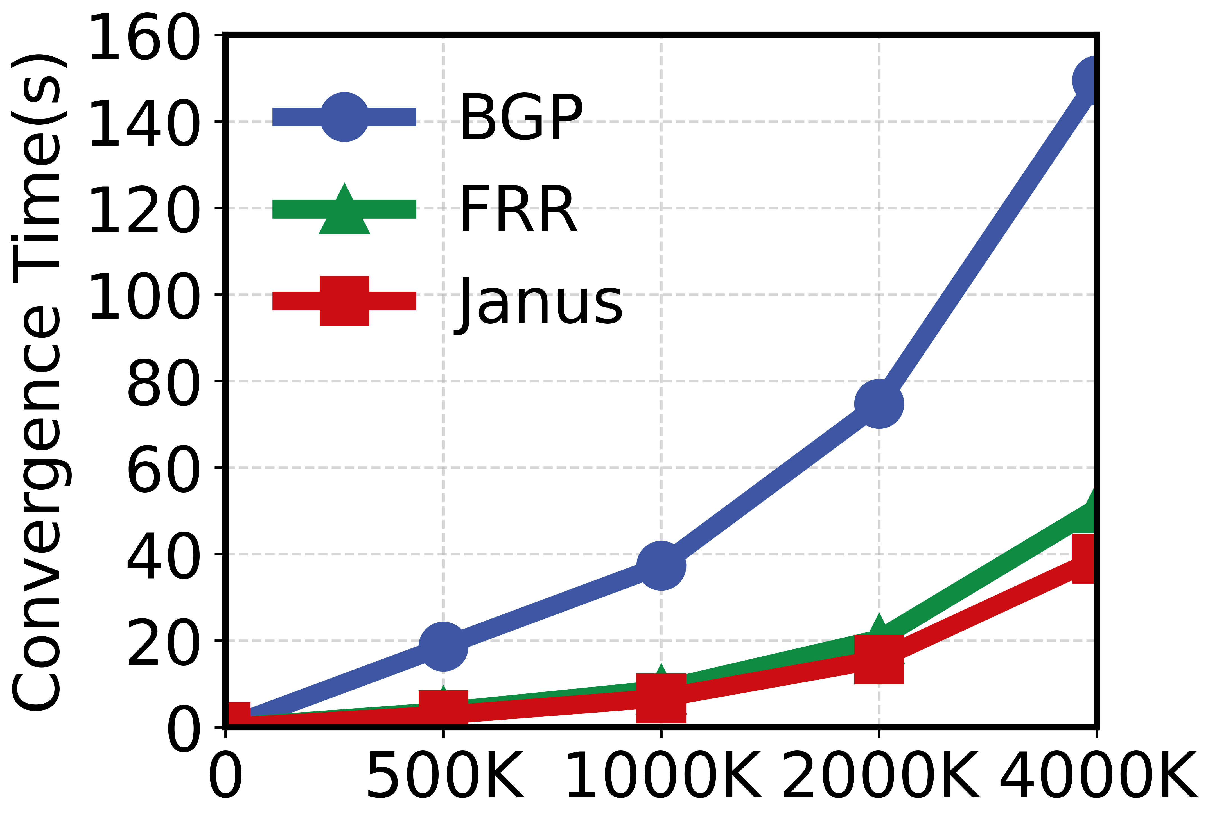
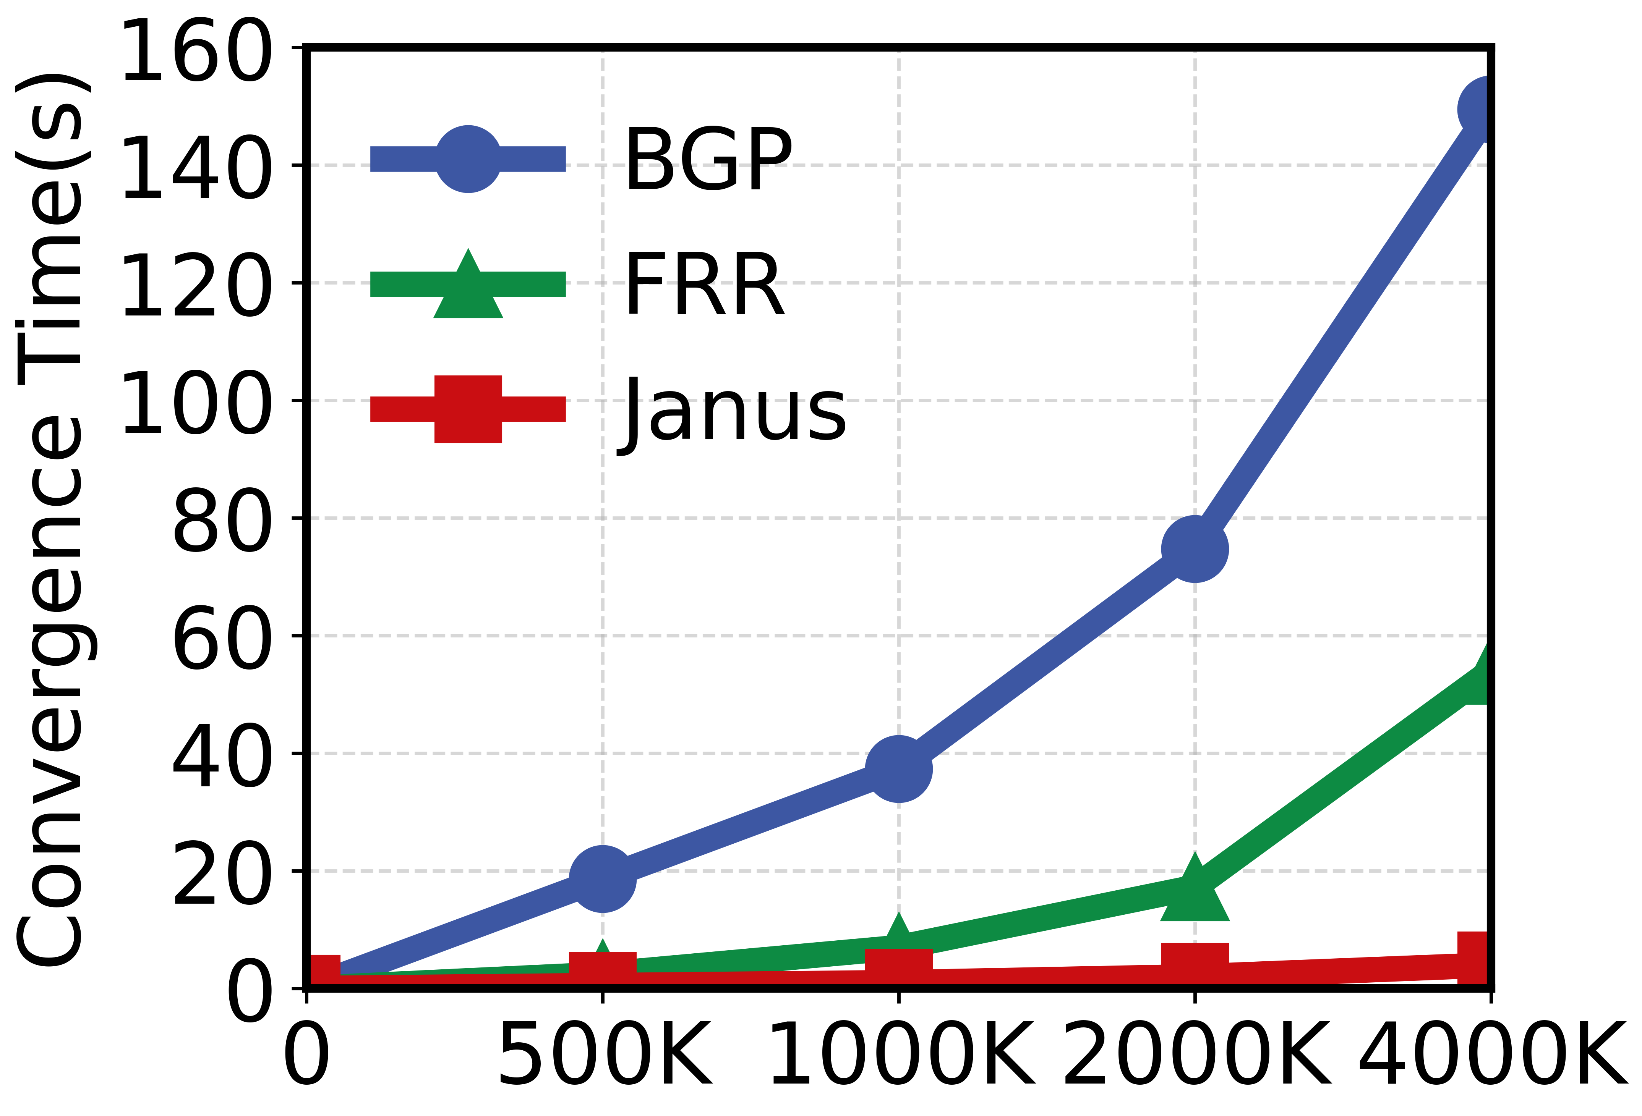
Result: Convergence Time
~4 seconds route Withdrawal Latency
Advertising
Withdrawal
Janus is orders of magnitude faster than existing FRR implementations and commercial routers.
Notes:
Janus is orders of magnitude faster than existing FRR implementations and commercial routers, providing second-level latency for withdrawl.

Slide 18
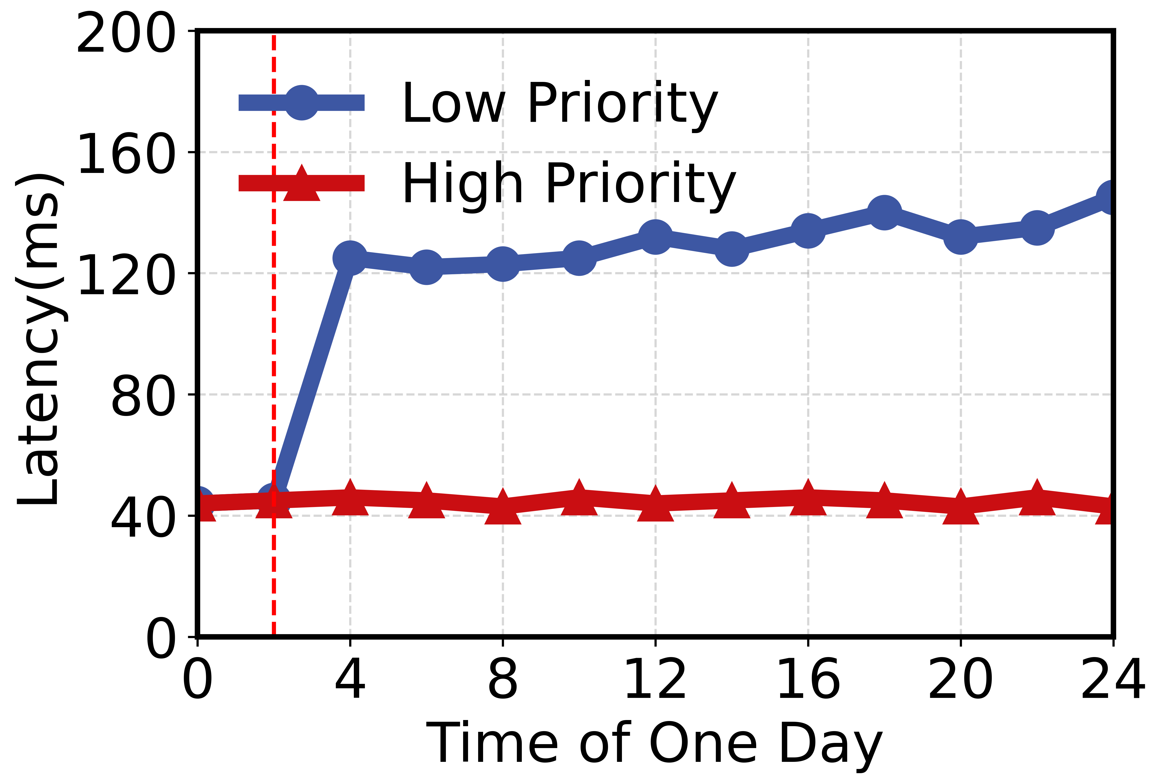
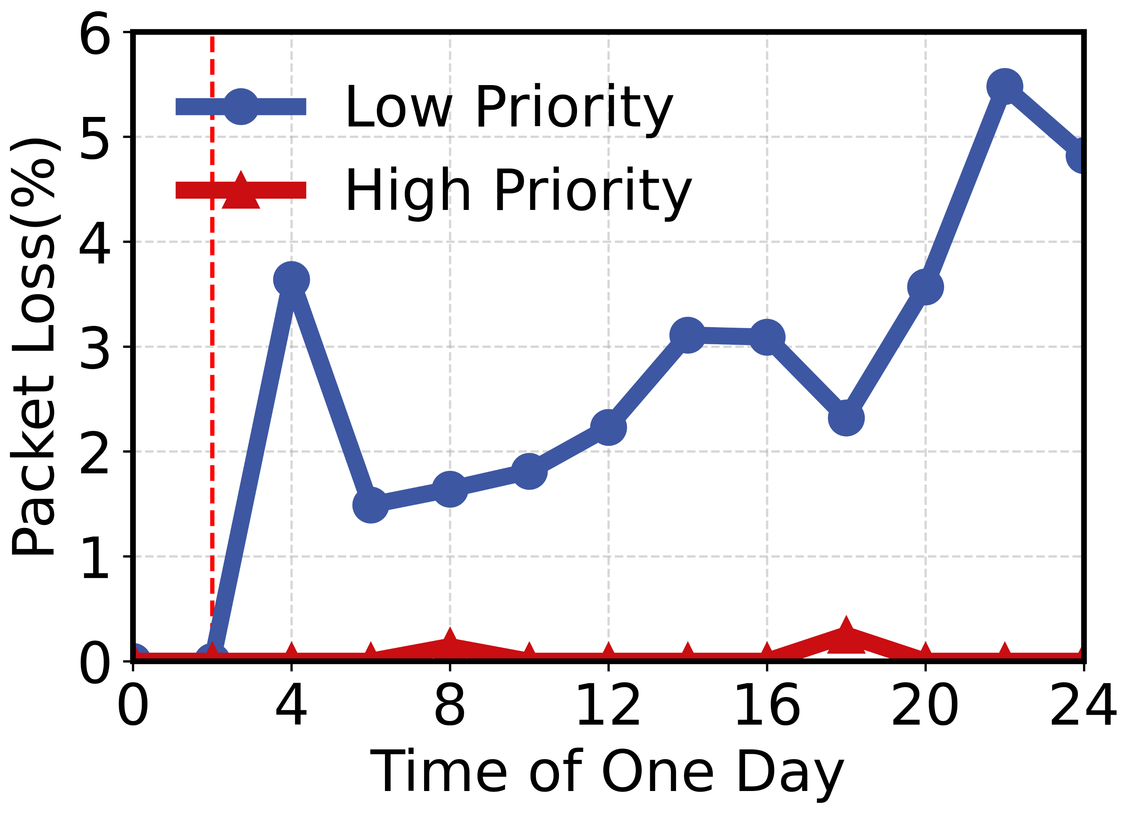
Result: Application-Aware Routing
High QoS for Priority Traffic
Packet loss
Latency
Notes:
Our application-aware routing guarantees low latency and loss for high-priority traffic, while cutting total bandwidth cost by up to 50% via optimal peer selection.

Slide 19
Lessons Learned
Run BGP on peering switches directly
This simplifies the control plane and reduces complexity by avoiding unnecessary intermediate layers.
DDoS must be scrubbed at edge switches
Hosts are too vulnerable to be on the critical path; filtering malicious traffic at the network edge provides essential protection.
01
02
Disaggregate routing from controller
Decoupling these two functions improves both system scalability and overall robustness.
Use hybrid switch-host for scalability
The combination of switch-based and host-based offloading offers the best of both worlds in terms of performance and flexibility.
03
04
Notes:
From large-scale deployment, we learned four key lessons: run BGP directly on peering switches to reduce complexity; scrub DDoS at edge switches, not hosts; disaggregate routing from the controller; use switch-host hybrid architecture for optimal scalability.

Slide 20
Conclusion
We propose Janus, a programmable switch-based peering architecture.
Janus reduces hardware cost by 78% and achieves sub-5-second route convergence.
We hope our production deployment can inspire the re-design of global Internet peering systems!
Notes:
As a conclusion, Janus is the first large-scale peering system using programmable switches at the Internet edge. It achieves 78% cost reduction, 4-second fast convergence, strong DDoS resilience, and application-aware routing, fully deployed in Tencent’s global production network. Thank you, and I’m happy to take any questions

Slide 21
Motivation: Three Critical Pain Points
Current systems suffer from DDoS vulnerability, high cost, and slow convergence, creating an urgent need for a new design.
1.6–16× more than switches
4,200 attacks in 3 months, with 15.5% overflows
DDoS Flood
High Cost
Slow Convergence
Notes:
From our production data, we found three fatal pain points. First, DDoS floods: over 4,200 attacks in 3 months, 15.5% of them overload host processing capacity. Second, extremely high cost: host servers cost 1.6 to 16 times more than switches. Third, slow convergence: traditional systems take minutes to update millions of routes upon failure. All these problems mean we need a brand-new peering design

Slide 22
Key Observation
A small number of routes carry most traffic.
Traffic is highly skewed
A tiny fraction of routes carry the majority of traffic.
80%
of traffic is carried by
Top 1.7% routes
90%
of traffic is carried by
Top 7.6% routes
This observation enables our “hot route offloading” design.
Notes:
Before diving into details, here’s our key observation from two years of production measurements: traffic is highly skewed. Only 1.7% of routes carry 80% of traffic, and 7.6% carry 90%. This is the foundation of our hot-route offloading design.

Slide 23
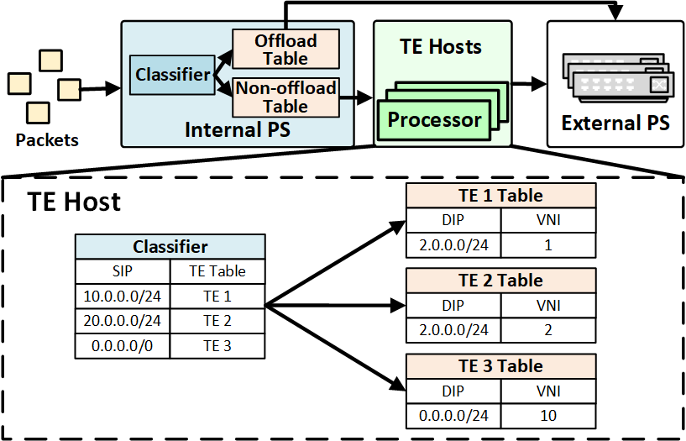
Application-aware Routing
Two-level Classifier
Internal PS
Coarse-grained identify and classify the flows
TE Host
Performs deep packet inspection (DPI) on flows and applies granular QoS policies
Elephant Flow Offload
Identified elephant flows are dynamically offloaded from the end-host to the switches.
Notes:
Next, application-aware routing. We use a two-level classifier: internal switch for coarse-grained classification, hosts for fine-grained QoS policies. We also design a hash-based elephant flow identification mechanism, dynamically offloading elephant flows to switches to avoid host overload.

Slide 24


Key Challenges We Solve
DDoS Overwhelms Hosts
Inbound malicious traffic can easily overwhelm vulnerable hosts.
Limited Switch ASIC Entries
Switch TCAM size (e.g., 320K) is smaller than the full BGP table (e.g., 1M+).
Slow BGP Convergence
Millions of route updates in seconds to maintain connectivity.
Balance Performance & Flexibility
Retaining fine-grained policy flexibility.
Notes:
So what are the core challenges we need to solve? First, switch ASICs only have 320K entries, far less than 1M+ Internet routes. Second, hosts are easily overwhelmed by DDoS. Third, millions of route updates are too slow. Fourth, we must balance high forwarding performance and flexible policy control. Janus addresses all four challenges.

Slide 25
Thank You!
Contact email:
Notes:
To conclude, in this work, We systematically measurement and analyze the irregularity phenomenon in LLM training. Considering the communication of model training, we design a localization system for irregularity from network perspective and experimentally demonstrate its effectiveness.

