Slide 1



PreAcher: Secure and Practical Password Pre-Authentication by Content Delivery Networks
Shihan Lin¹, Suting Chen², Yunming Xiao³, Yanqi Gu⁴, Aleksandar Kuzmanovic², Xiaowei Yang¹
¹Duke University, ²Northwestern University, ³University of Michigan, ⁴UCI

Slide 2
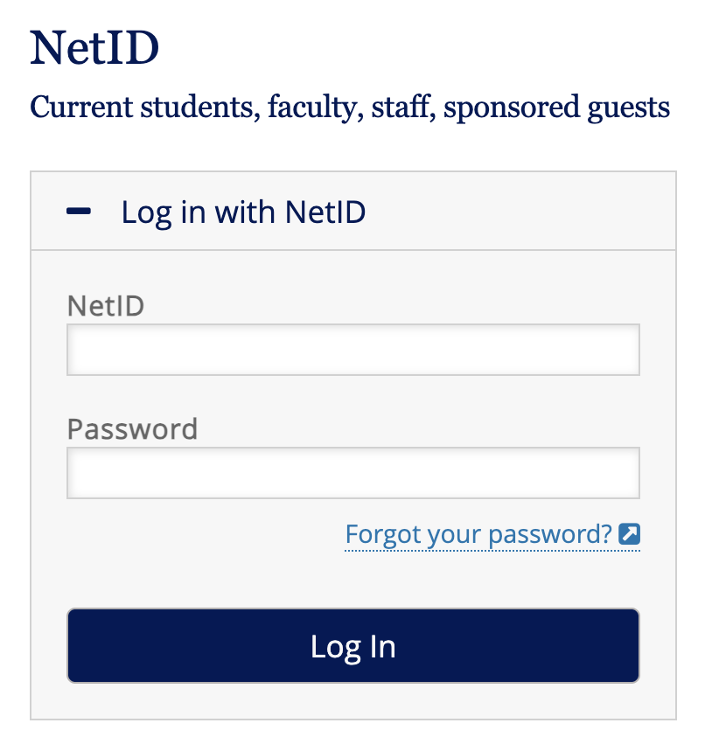
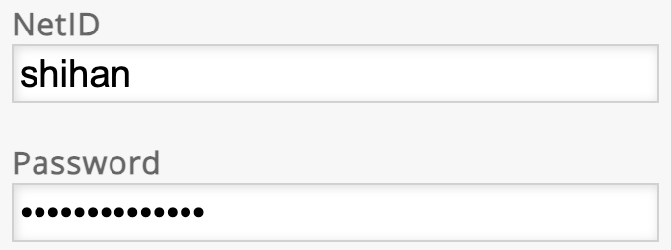

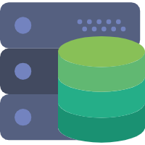
Motivation
Password login is prevalent on the Internet
User
Web Server
Notes:
Nowadays, password login is …
However, there are a lot of problems with password authentication

Slide 3


Password Login is Vulnerable to ADoS Attacks
Application-layer Denial of Service (ADoS)
Exhaust a server’s CPU by a sending small amount of login traffic
DDoS usually takes a large amount of traffic
ADoS happens under credential stuffing attacks
Attackers repeatedly try many passwords to crack user accounts
Akamai reports 280 million suspicious logins per day*
Username: shihan
Password: 123?
Password: abc?
Password: 123abc?
150 logins/sec
Attacker
Web Server
*https://www.akamai.com/glossary/what-is-credential-stuffing

Slide 4



Password Authentication is Slow
Password hashing is designed to be slow
scrypt (RFC-7914), PBKDF2 (RFC-8018), Argon2 (EuroS&P’16)
Prevent brute-force attacks when database is leaked
Hash(123)
Hash(Hash(……(Hash(123))))
User
Web Server
Username: shihan
Password: 123
User1: Hash(pass1) User2: Hash(pass2)
…
Attacker
Notes:
...
Nowadays, when user send login requests, the server verify the password by calculating a hash value. This hash value should not be a simple hash, such as sha1 or sha2. Instead, it needs to be a slow password hashing.

Slide 5


ADoS Proof of Concept
Bypass existing defense provided by Cloudflare
150 logins/sec
150 logins/sec
Attacker
Cloudflare (DoS, Firewall, Rate limit, Bot detection)
4-core Server
CPU Util: 100%
Distributed Bots
Notes:
Here we show a real-world example of ADoS attacks. We successfully bypass existing defense provided by Cloudflare to launch ADoS attacks.
In this experiment,

Slide 6



Existing Solutions & Limitations
Solutions | DoS Prevention | Password Secrecy/ Account Security | Usability
CAPTCHA
Two-factor authentication (2FA)
Rate limit
Bot detection
Single Sign-On (SSO)
PreAcher
Notes:
There are some existing solutions nowadays.
For example, a website may use CAPTCHA, but CAPTCHA can be solved by current AI technology
A website may also use two-factor authentication, but 2FA uses passwords as the first factor.
And Rate Limit cannot defend against the DoS either, because attackers can use VPN to switch their IP addresses
Nowadays, some CDN providers have deploy bot detection to help websites detect bot traffic. However, such bot detection is based on machine learning and behavior analysis, cannot avoid false positive and false negative.
Finally, websites may use single sign-on, for example you can use google account to sign into a website. but It may lead to single point of failure: if the account of sso provider is compromised, all associated websites are at a risk.
Therefore, In this work, we propose PreAcher, which provides DoS prevention, preserve password secrecy, and maintain good usability.

Slide 7

Threat Model & Assumptions
Passive Attackers inside CDNs
Observe, not modify messages
Real-world example: Web Cache Deception (WCD)
USENIX’20, USENIX’22
Active Attackers outside CDNs
Observe, modify, and duplicate messages
Attacks inside and outside CDNs cannot collude
CDNs will not launch ADoS/DDoS attacks
Account registration is DoS-resisted
Trust On First Use (TOFU)
E.g. Visit a local branch to open a bank account

Slide 8

Key Insight of PreAcher
Pre-Authentication on a CDN without exposing passwords to the CDN
filter out invalid logins without correct passwords
Password looks correct!
Client
CDN
Web Server
Wrong password!
Attacker
CDN
Web server
Notes:
The key insight of PreAcher is that we deploy a password pre-authentication on a CDN to filter out …
As the figure shows, if the attacker send login requests with wrong passwords, they will be intercepted and filtered out by the CDN.
This idea is simple, however

Slide 9


Unfortunately…
Attackers inside CDNs may impersonate users
Offline Dictionary Attacks (ODAs) by attackers inside a CDN
Help me login, bro!
User authentication succeeds!
Attacker
CDN Insider
Web server
CDN Insider
Historical Passwords,
Leaked Passwords, Weak Passwords…
Processing
Self Auth
Password Dictionary
Notes:
However, there are two problems with this simple idea: one is that xxxx and another xxx
For the first one, a malicious CDN insider can help the attacker to cheat the web server even the attacker does not know the password
For the second one, a CDN can collect …
Run the pre-authentication system by itself and try all the passwords in the dictionary

Slide 10
Solution: Pre-Auth + Full Auth
Attackers inside CDNs may impersonate users
Involve the server to double check the authentication
Pre-authentication on the CDN
Full authentication on the server
Help me login, bro!
User pre-auth succeeds!
No, full auth fails!
Attacker
CDN
Web server
Notes:
Our to solution to avoid … is …
We have pre-auth … and full auth …
Specifically, when the CDN tries to cheat the web server, the web server will find that the requests actually fails on the full authentication

Slide 11
Solution: Locality-Sensitive Hashing (LSH)
Offline Dictionary Attacks (ODAs) by attackers inside a CDN
Observation: Passwords in a dictionary share certain similarities
Idea: Group similar passwords into one pseudo-password for Pre-Auth
Locality-Sensitive Hashing (LSH)
So many candidates can pass pre-auth.
Have to query the server to know the real one.
UserID: shihan
Dictionary
abc123
abc123!
123Abc
edg567
Edg567!
……
LSH
0x5f6e
CDN Insider
Historical Passwords,
Leaked Passwords, Weak Passwords…
LSH
Processing
0xa3b2
Self Auth
Password Dictionary
Notes:
Our solution to solve the
We observe that
so we come up with an idea
which can achieved by LSH
….
Therefore, when CDN tries passwords in the dictionary, it will find

Slide 12
What if the CDN tries many online queries?
Detect the attacks when the server receives >Q failed full authentication queries
These passwords all pass pre-auth for a user
So many passwords failed on full auth but passed pre-auth.
Something bad happens.
CDN
Web server
Notes:
But what if …
Actually, the server can detect …
The CDN may send many password candidate to the server for online queries, but the server will find that so many

Slide 13
Put All Together: PreAcher
p’=LSH(p) for pre-auth M=Enc(p) for full auth
User pre-auth succeeds!
Pre-Auth
p=Dec(M)
Full auth succeeds!
User
CDN
Web server

Slide 14


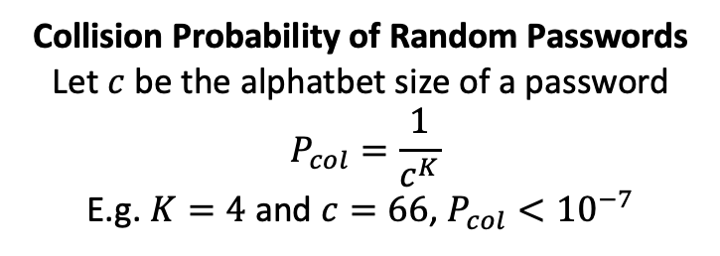

LSH Algorithms
Weighted K-mer MinHash
$p′$: Minimum element from $\left\{HMAC\left(u, s\right) | s ε S\right\}$, where $u$ is the username
Password $S$:
a | b | c | d | e | 1 | 2 | 3 | 4 | 5
$$K=3$$
s₁=“abc”
s₂=“bcd”
. . . . . .
s₈=“345”
Collision Probability of Random Passwords
Let $c$ be the alphatbet size of a password
$$P_{col}=\frac{1}{c^{K}}$$
E.g. $K=4$ and $c=66$, $P_{col}<{10}^{−7}$

Slide 15
Implementation & Deployment
Server operations
C++ library
Implemented by web developers
Client operations
JavaScript library
Imported by web developers into webpages
CDN operations
Serverless computing service on CDNs
JavaScript code snippet
Deployed by web developers
Web developers can unilaterally deploy PreAcher to protect their websites!
Notes:
Moreover, PreAcher's implementation makes it easy to deploy

Slide 16
Evaluation
Testbed experiment
Use Azure VMs as the client, server, CDN
Internet experiment
Use Azure VMs as the client and server
Use Cloudflare as the CDN
Two strawman solutions
Baseline
A CDN simply forwards every login request to the server
SGX-CDN
Use SGX on a CDN to fully authenticate users to filter out invalid logins
Notes:
Finally, to evaluate PreAcher, we setup two experiments

Slide 17
Evaluation: ADoS Defense
User traffic: 100 valid logins/sec
Measure the throughput of valid logins
Notes:
In our evaluation of ADoS defense, We first send user traffic with 100 valid logins/sec through CDN to the server, and we masure the throughput of …
We can find that all three methods can achieve a throughput close to 100 logins/sec no matter on the testbed or the Internet.
Since Cloudflare does not enable SGX, we don’t have results for SGX-CDN on the Internet

Slide 18
Evaluation: ADoS Defense
User traffic: 100 valid logins/sec
Attack traffic: 400 invalid logins/sec
Measure the throughput of valid logins
Notes:
However, once we have attackers send 400 invalid logins/sec. Both Baseline and SGX-CDN cannot serve any valid user logins.
But PreAcher can still maintain a throughput close to 100 on the testbed and the Internet.

Slide 19



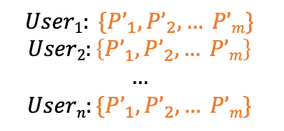
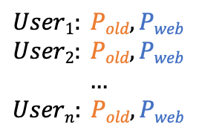

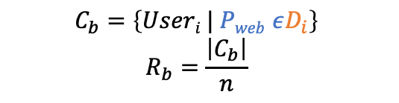
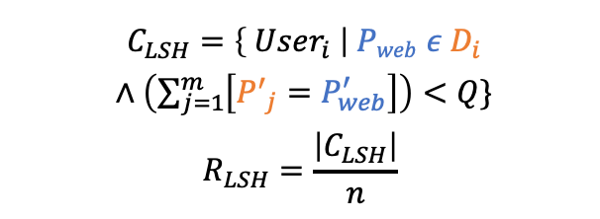

Evaluation: Locality-Sensitive Hashing (LSH) Efficacy
Simulate an attacker inside a CDN to crack $n=5k$ user accounts
For each user, generate a dictionary with $m=10k$ passwords
$$User1: Pold$$
$$User2: Pold$$
$$…$$
$$Usern: Pold$$
pass2path
(S&P’19)
$$User1:D_{1}=\left\{P1, P2, … P_{m}\right\}$$
$$User2:D_{2}=\left\{P1, P2, … P_{m}\right\}$$
$$…$$
$$Usern:D_{n}=\left\{P1, P2, … P_{m}\right\}$$
$$User1: \{P’_{1}, P’_{2}, … P’m\}$$
$$User2:\left\{P’_{1}, P’_{2}, … P’m\right\}$$
$$…$$
$$Usern:\{P’_{1}, P’_{2}, … P’m\}$$
LSH
Historical Passwords
Password Dictionary
Pseudo-Password Dictionary
$C_{LSH}=\left\{ User_{i} \right| Pweb ε D_{i}$
$∧\left(\sum_{j=1}^{m}{\left[{P^{′}}_{j}=P_{web}^{′}\right]}\right)<Q\}$
$$R_{LSH}=\frac{\left|C_{LSH}\right|}{n}$$
$$User1: Pold, Pweb$$
$$User2: Pold, Pweb$$
$$…$$
$$Usern: Pold, Pweb$$
$$C_{b}=\left\{Useri | Pweb εD_{i}\right\}$$
$$R_{b}=\frac{\left|C_{b}\right|}{n}$$
Passwords Dataset
(4iQ)
Cracking Rate w/o LSH
Cracking Rate w/ LSH
$$User1: Pweb$$
$$User2: Pweb$$
$$…$$
$$Usern: Pweb$$
$$User1: P’web$$
$$User2: P’web$$
$$…$$
$$Usern: P’web$$
LSH
Actual Passwords
Actual Pseudo-Passwords
Notes:
….
In our simulation, by comparing P_web and passwords in dictionary, we can count how many users’ P_web is in the dictionary. Then …
…
By comparing P’_web and pseudo-password in dictionary, we can find the cracked users.
Specifically, the difference between this formular and the previous one, is that we not only require P_web appear in the dictionary, but also for each user, we count how many P’ in the dictionary is equal to the real P’_web. If the number is less than Q, it means the attacker in CDN can find these passwords with correct p' offline and try all these passwords with less than Q online query to server to find out the real password

Slide 20
Evaluation
Throughput
The numbers above bars indicate the throughput and CPU utilization
Server side has the same logic: Similar throughput
PreAcher achieve a high throughput on CDN
Testbed
Internet

Slide 21
Evaluation
Latency
Client: Viriginia, US
Geographically distributed web servers
Use Cloudflare as the CDNs
Acceptable latency overhead since the login is usually a one-time cost

Slide 22


Evaluation: LSH Efficacy
Simulate an attacker inside a CDN to crack 5000 user accounts
Use pass2path (S&P’19) algorithm and 4iQ dataset to generate password dictionaries
Compute the cracking rate of user accounts when PreAcher is deployed
$K$: The parameter of LSH algorithm (Weighted K-mer MinHash)
$Q$: The failure number after which will the server report an ODA
Trade off between ADoS defense and ODA prevention
The percentage of Invalid logins that pass pre-auth: $\frac{1}{c^{K}}$ , $c$ is the alphabet size
$K=4, Q=20$, cracking rate < 0.20%, $\frac{1}{c^{K}}<{10}^{−7}$
Notes:
We also evaluate our LSH efficacy. We simulate an …
…
Here, the cracking rate is determined by K and Q, where …
The figure shows the cracking rate of user accounts. We can find that larger K and Q leads to larger cracking rate.
Actually, the K value selection is a trade off between ...

Slide 23

Evaluation: LSH & SHA-256
Comparing cracking rates with the same penetration rate
N-bit truncated SHA-256
Penetration rate: $\frac{1}{2^{N}}$
LSH by Weighted K-mer MinHash
Penetration rate: $\frac{1}{c^{K}},c=66$

Slide 24

Conclusion: PreAcher
Securely pre-authenticate users on CDNs
Filter out malicious login requests without correct passwords
CDNs cannot access or guess user passwords
Immediate deployable on the Internet by web server unilaterally
JavaScript for client operations
Serverless computing for CDN operations
Code: https://github.com/SHiftLin/NSDI2025-PreAcher
Thank you!
Q&A
NSDI2025-PreAcher

Slide 25
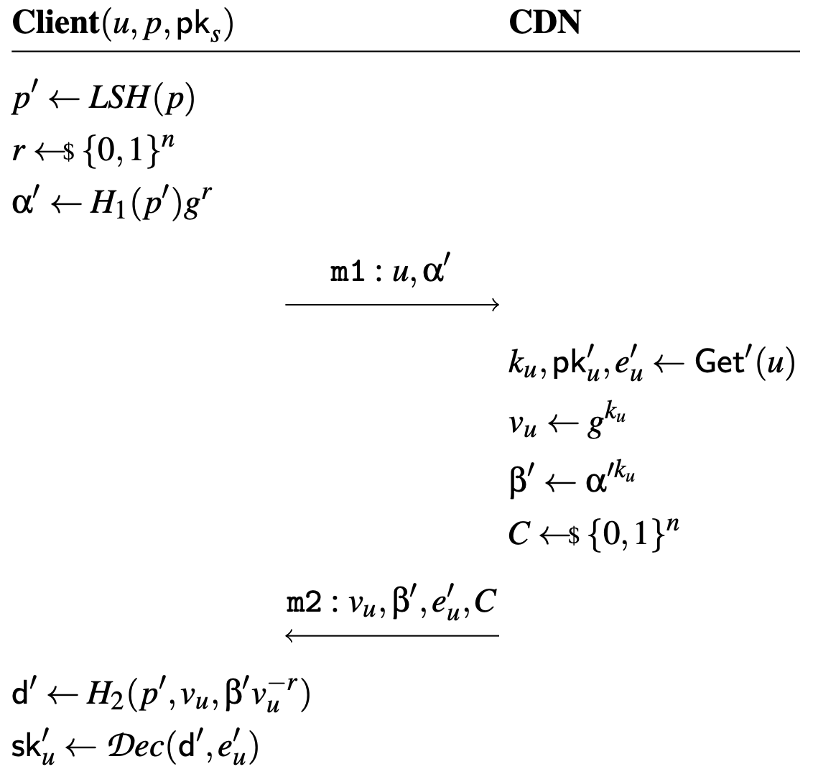
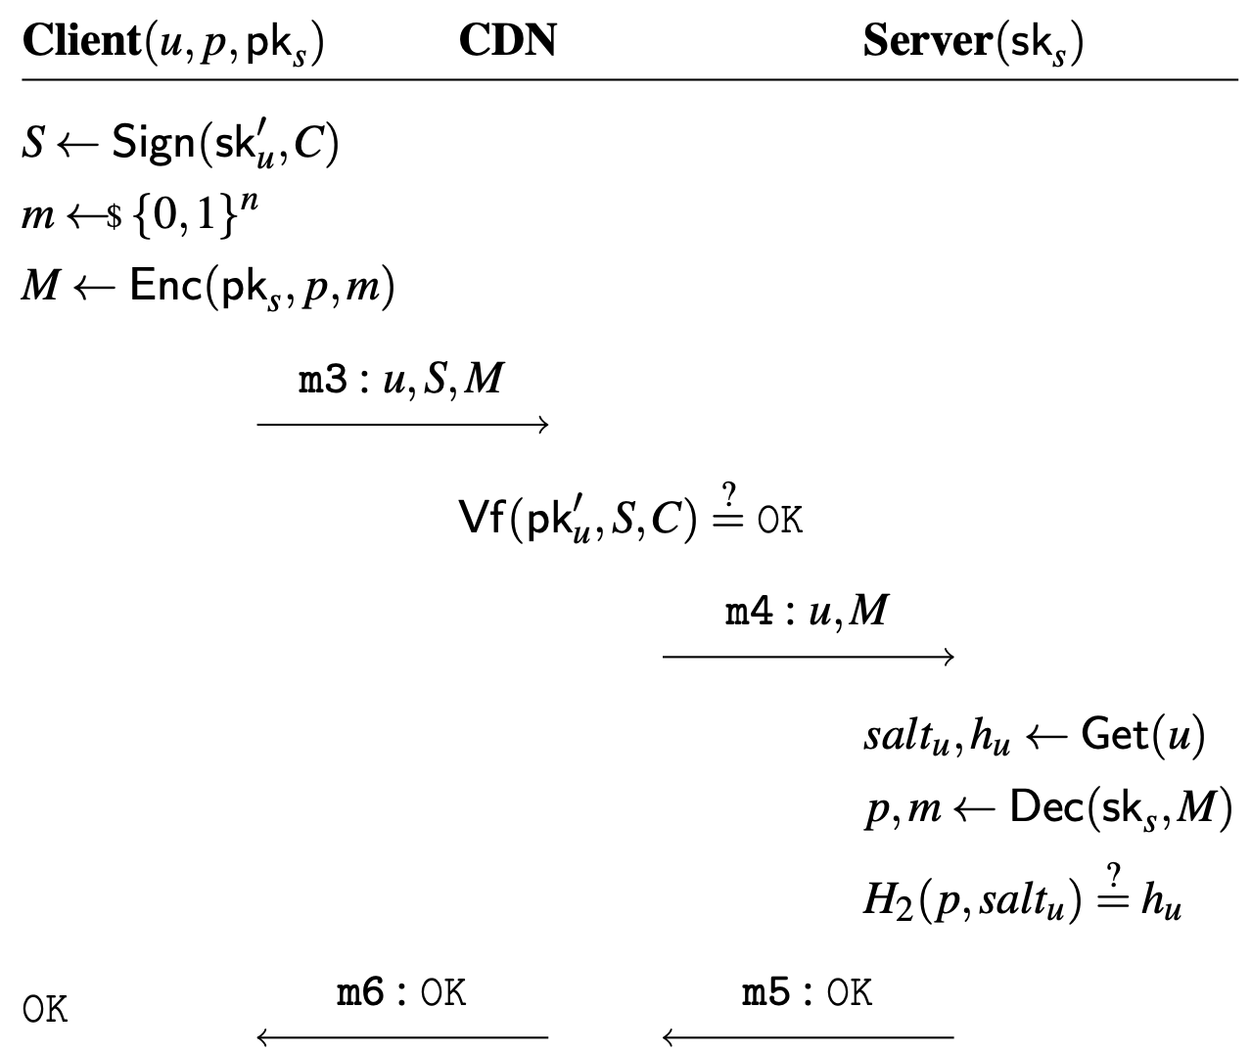

Formal Protocol
OPRF
First Round (OPRF)
Second Round (Pre-Auth & Full-Auth)
Notes:
This slide shows the formal protocol of PreAcher.
I will not introduce the detail of this protocol, but I will briefly describe some techniques here

Slide 26
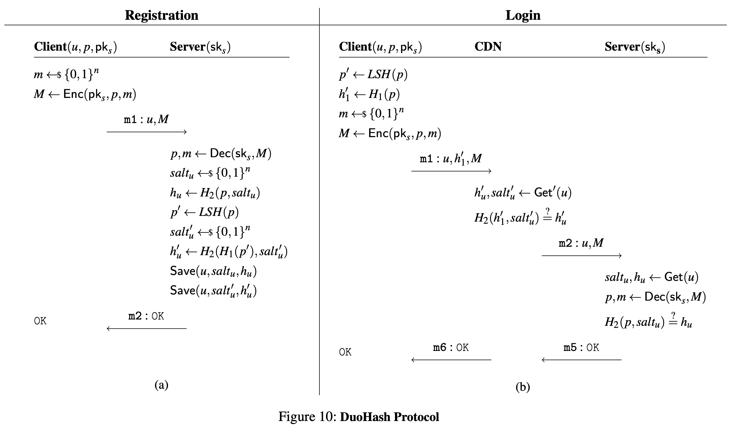
DuoHash Protocol

Slide 27
Evaluation
Throughput
Testbed
Internet

Slide 28
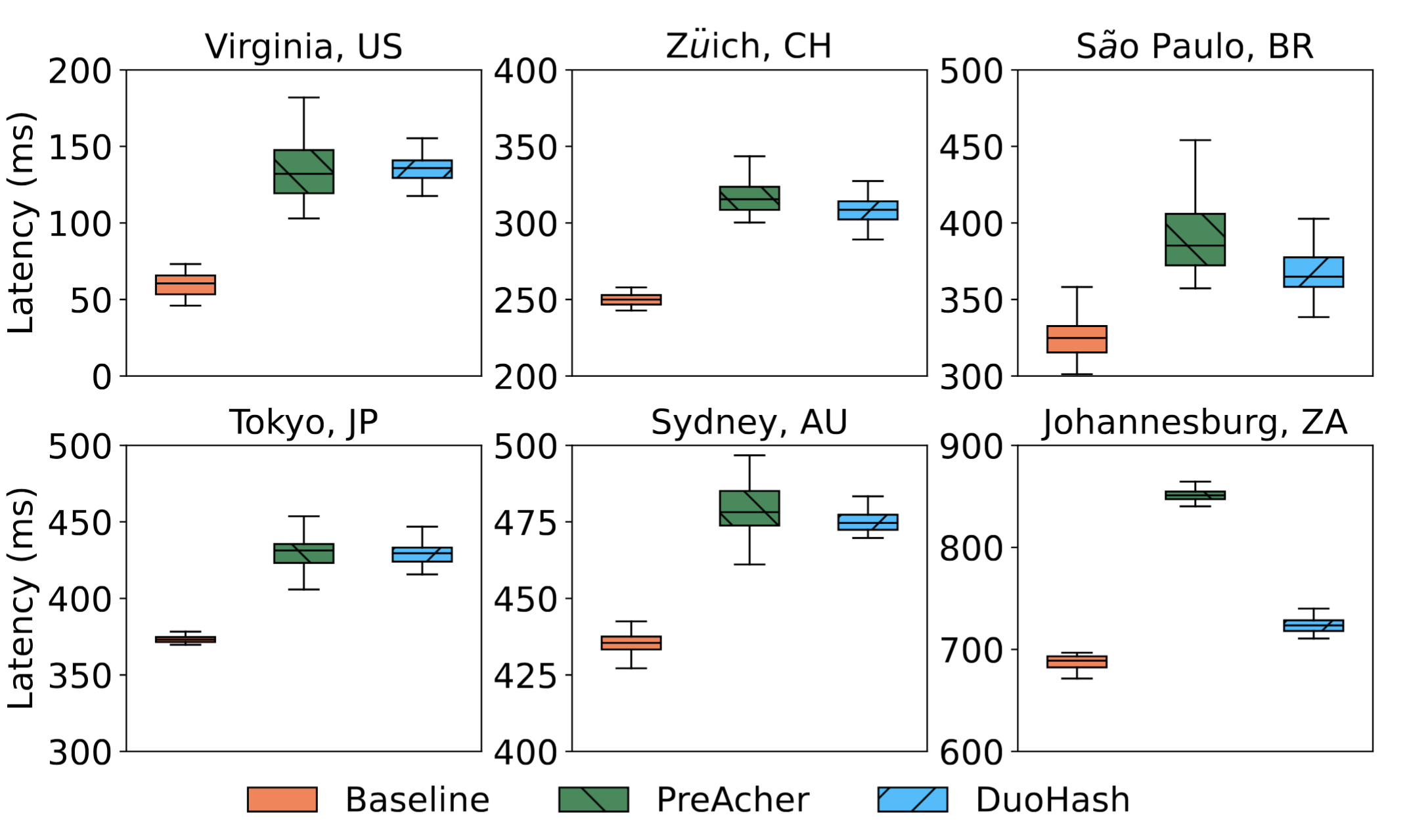
Evaluation
Latency

